Slide 1
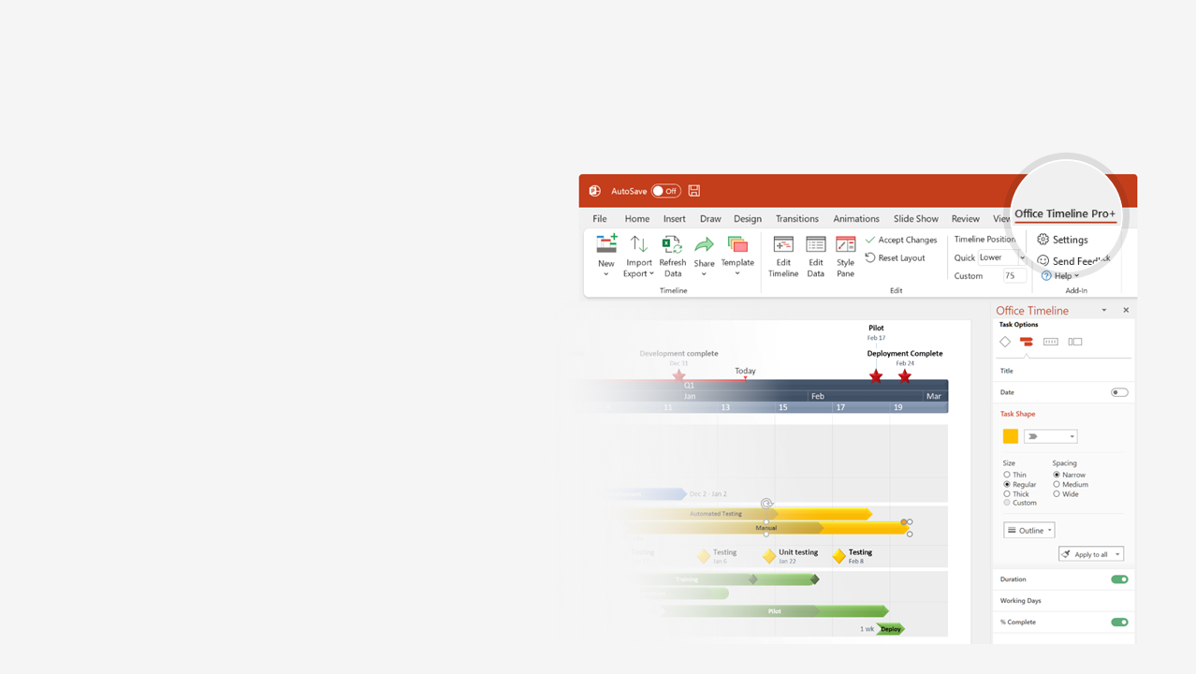

How to update this template in seconds
The Office Timeline add-in for PowerPoint will help you edit it with just a few clicks.
Get your free 14-day trial of Office Timeline here:
https://www.officetimeline.com/14-days-trial
Re-open this template, and create your impressive
PowerPoint visual in 3 easy steps:
1
Click the Edit Data button on the Office Timeline tab.
2
Use the Data and Timeline views to edit swimlanes, milestones and tasks.
3
Click Save to instantly update the template.

Slide 2

History of
LABOR DAY
First Labor Day parade
- New York -
Declared official holiday
in Oregon
Feb 21, 1887
Declared a national
public holiday
Sep 5, 1882
Labor Day celebrated
in many cities
Jun 28, 1894
1885
1882
1884
1886
1888
1890
1892
1894
May 4, 1886
May 11, 1894
Haymarket Riot
- Chicago -
Pullman Strike
- Chicago -

