Slide 1
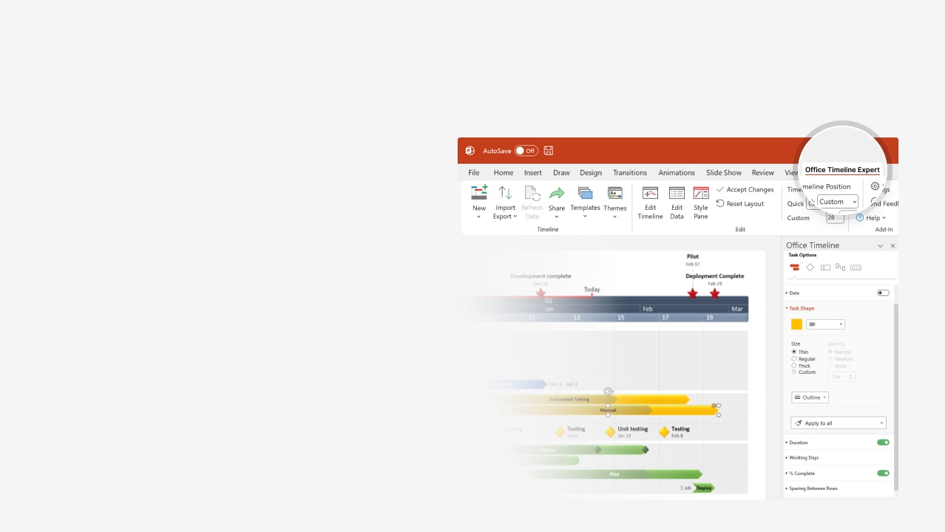

How to update this template in seconds
The Office Timeline add-in for PowerPoint will help you edit it with just a few clicks.
Get your free 14-day trial of Office Timeline here:
https://www.officetimeline.com/office-timeline/14-days-trial
Re-open this template, and create your impressive
PowerPoint visual in 3 easy steps:
1
Click the Edit Data button on the Office Timeline tab.
2
Use the Data and Timeline views to edit swimlanes, milestones and tasks.
3
Click Save to instantly update the template.

Slide 2
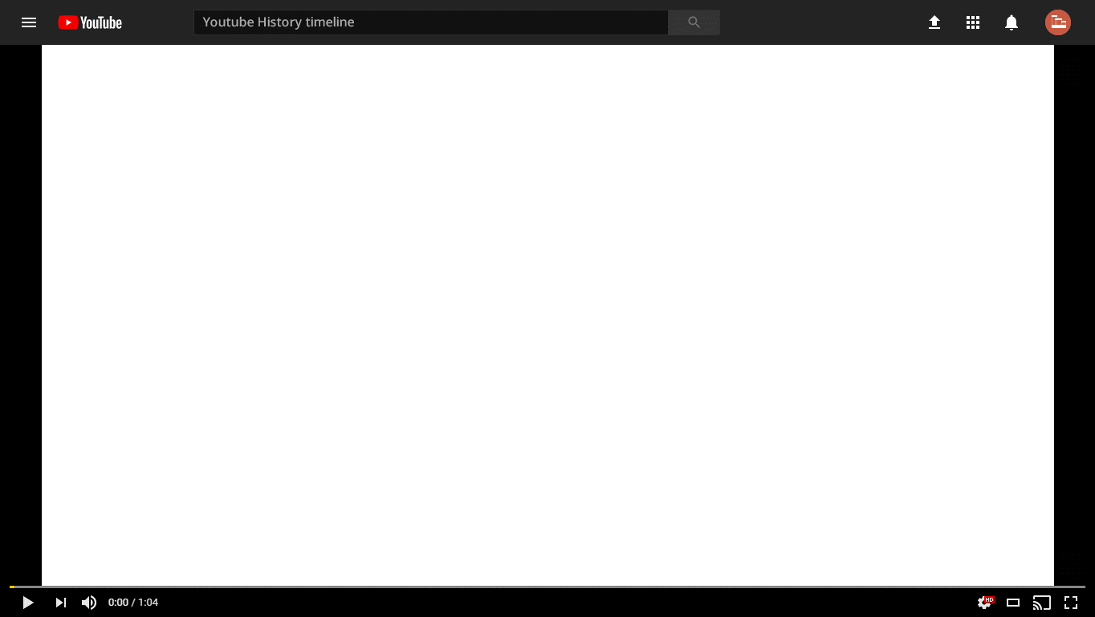

YouTube history timeline
Second most popular social network
2022
YouTube.com registered
Shorts >50 billion daily views
2005
2023
Official launch
Peabody Award
Susan Wojcicki (CEO) steps down
2005
2009
Buys $215 million office park
2023
2016
Removes categories
Focuses on AI
Acquired by Google
1 billion views/day
First 1 billion-hit video
2020
2006
2009
2012
2024
2005
2007
2009
2011
2013
2015
2017
2019
2021
2023
Filtering launched
In-video ads
YouTube Live
Turkey bans YouTube (2nd time)
Video Reach advertising platform
Crackdown
ad blockers
2006
2007
2011
2014
2018
2023
YouTube's Partner Program
Vevo (in partnership with Vivendi)
YouTube Red
YouTube Red rebranded
as YouTube Premium
YouTube Go shutting down
2007
2009
2015
2018
2022
YouTube Rentals
60 fps videos are introduced
YouTube Go
YouTube TV
Creator Studio phased out
Handles
2010
2014
2016
2017
2019
2022
New logo for the first time
YouTube headquarters shooting
Removes dislike count
2017
2018
2020

