Slide 1
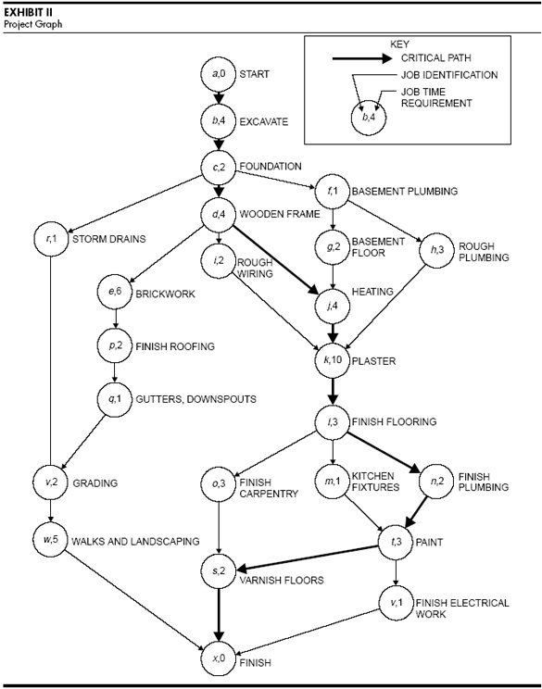

Slide 2

Day 1
4
7
10
13
16
19
22
25
28
31
34
Plumbing
2 d
Rough plumbing
2 d
Finish plumbing
3 d
Paint
Finishing
1 d
Finish
electrical work
Basement plumbing
1 d
Heating
Basement floor
2 d
4 d
Interiors
Plaster
10 d
3 d
Finish flooring
1 d
Kitchen fixtures
Start
Apr 2
4 d
Excavation
2 d
Foundation
Frame
4 d
Wooden frame
Rough wiring
Finish carpentry
Varnish floors
2 d
3 d
2 d
End
May 7
6 d
Brickwork
Exteriors
2 d
Finish roofing
1 d
Gutters
Terrace
2 d
Storm drains
2 d
Grading
5 d
Landscaping

Slide 3


How to update this template in seconds
The Office Timeline add-in for PowerPoint will help you edit it with just a few clicks.
Get your free 14-day trial of Office Timeline here:
https://www.officetimeline.com/14-days-trial
Re-open this template, and create your impressive
PowerPoint visual in 3 easy steps:
1
Click the Edit Data button on the Office Timeline tab.
2
Use the Data and Timeline views to edit swimlanes, milestones and tasks.
3
Click Save to instantly update the template.

