Slide 1
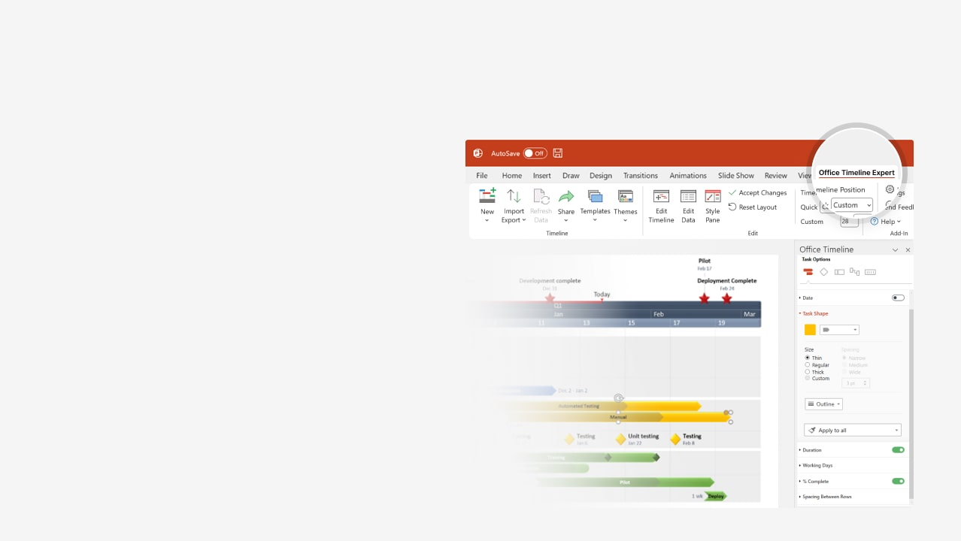

How to update this template in seconds
The Office Timeline add-in for PowerPoint will help you edit it with just a few clicks.
Get your free 14-day trial of Office Timeline here: https://www.officetimeline.com/office-timeline/14-days-trial Re-open this template, and create your impressive PowerPoint visual in 3 easy steps:
1
Click the Edit Data button on the Office Timeline tab.
2
Use the Data and Timeline views to edit swimlanes, milestones and tasks.
3
Click Save to instantly update the template.

Slide 2
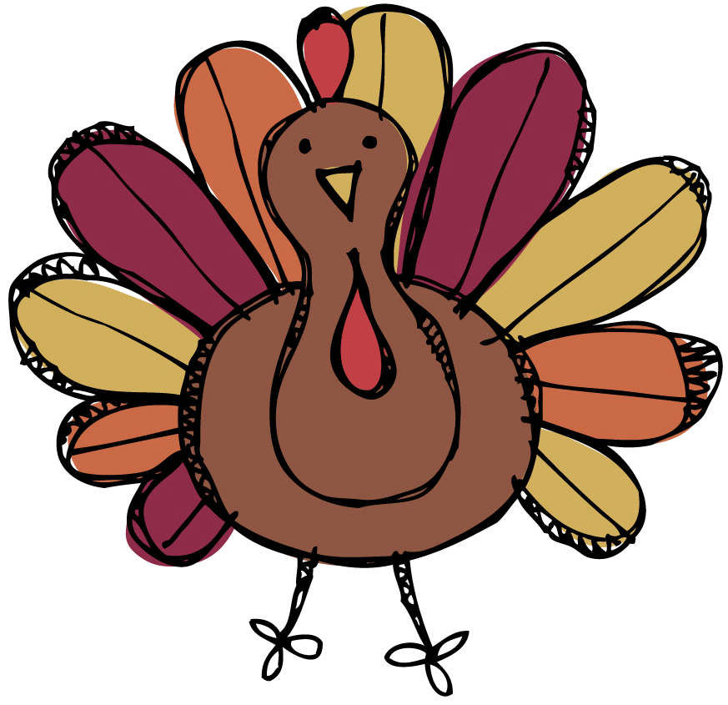

Early-bird Thanksgiving preparation timeline
2025
11/09
11/10
11/11
11/12
11/13
11/14
11/15
11/16
11/17
11/18
11/19
11/20
11/21
11/22
11/23
11/24
11/25
11/26
11/27
11/28
11/29
11/30
Sunday
Tuesday
Thursday
Saturday
Monday
Wednesday
Friday
Sunday
Tuesday
Thursday
Saturday
Confirm Guest List (RSVPs)
Decide the Menu
Prepare Shopping List
Mon Nov 10
Sun Nov 16
Fri Nov 21
Planning
Check Guests’
Dietary Requirements
Locate Cooking
Utensils
Inventory Dinnerware
and Plan Seating
Thu Nov 13
Mon Nov 17
Thu Nov 20
Pick a Centerpiece
Fri Nov 21
Purchase Beverages
Buy Hardy Vegetables
Shopping
Thu Nov 13
Sat Nov 22
Order Turkey
Shop for Heavy Cream
Mon Nov 17
Tue Nov 25
Stock Beverage Bar
Make Room in the
Refrigerator / Freezer
Prep Coat Racks with
Extra Hangers
Thu Nov 13
Sat Nov 22
Wed Nov 26
Prepping
Clean Linens / Silverware
Clean the House
Cut and Refrigerate
Veggies
Fri Nov 21
Sun Nov 23
Thu Nov 27
Table Arrangements / Centerpiece
Pick up the Turkey
Set the Tables / Chairs
Sat Nov 22
Wed Nov 26
Thu Nov 27
Cook the Pies / Breads / Biscuits
Thu Nov 27
Cooking
Prepare Sauces / Soups / Dips
Thu Nov 27
Store Casserole Ingredients
Thu Nov 27

Slide 3

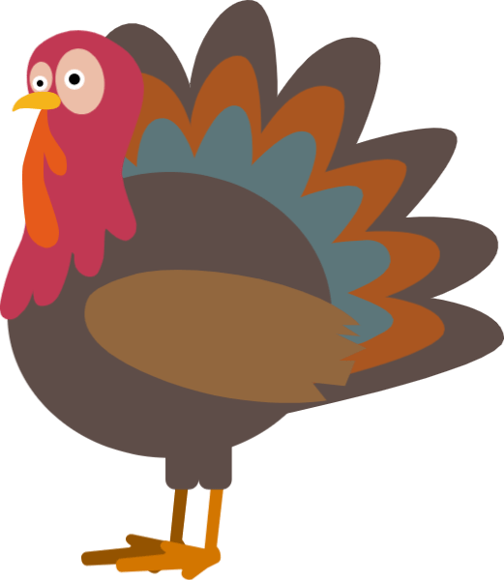


Thanksgiving dinner timeline: a race against the cluck
Take the turkey out of the fridge
Set the table
11:00 AM
3:00 PM
Put the turkey in the oven
Dinner is served!
11:30 AM
4:00 PM
8 am
9 am
10 am
11 am
12 pm
1 pm
2 pm
3 pm
4 pm
Peel & Chop
Fruits & Veggies
1.5 hours
Prep the Pumpkin
Pie Ingredients
30 m
Bake the Pumpkin Pie
30 m
Cook the Turkey
4 hours
Prep & Refrigerate Stuffing / Casseroles
30 m
Slow-Cook Mashed Potatoes
30 m
Prep the Gravy
30 m
Let the Turkey Rest
20 m

