Slide 1
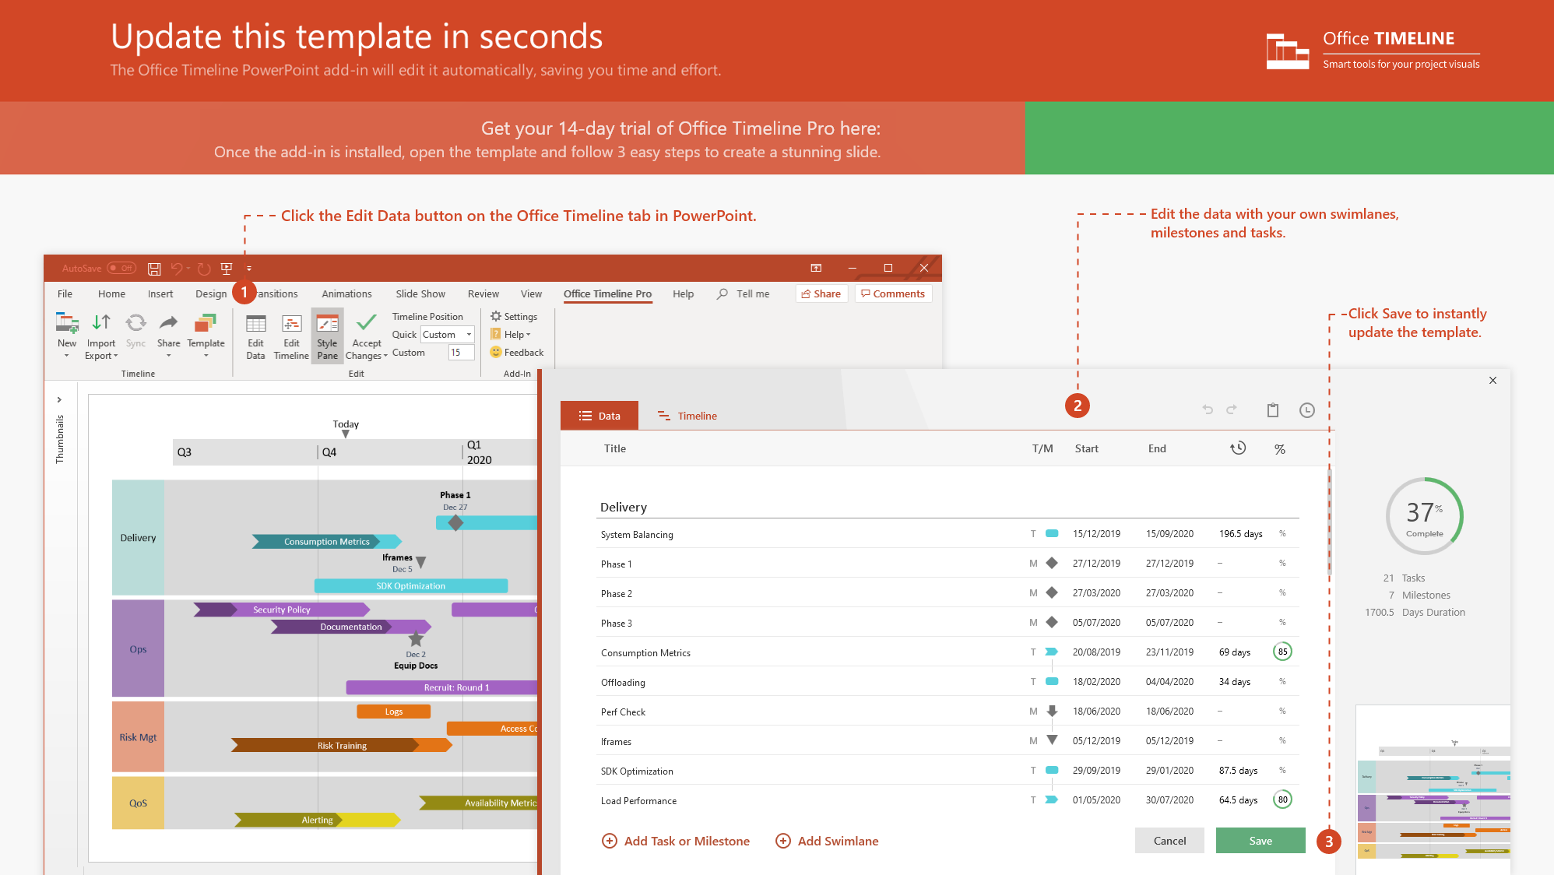
https://www.officetimeline.com/14-days-trial

Slide 2

Work from Home Daily Schedule
Tip: establishing a clear, simple routine can help you become more productive in self-isolation
7 am
8 am
9 am
10 am
11 am
12 pm
1 pm
2 pm
3 pm
4 pm
5 pm
6 pm
7 pm
8 pm
9 pm
10 pm
Wake up
Monday
to Friday
Exercise
Check email
Break
Break
Check email
Conference calls
To-do list
Clock out
Sleep
Getting ready
Work (solitary tasks)
Lunch
Work (collaborative tasks)
Dinner
Relaxation
Saturday
/ Sunday
Wake up
Light exercise
Wash hands
Catch up with friends
Book / Movie
Sleep
Sleep in
Chores
Groceries
Lunch
Chores
Dinner
Relaxation

