Slide 1
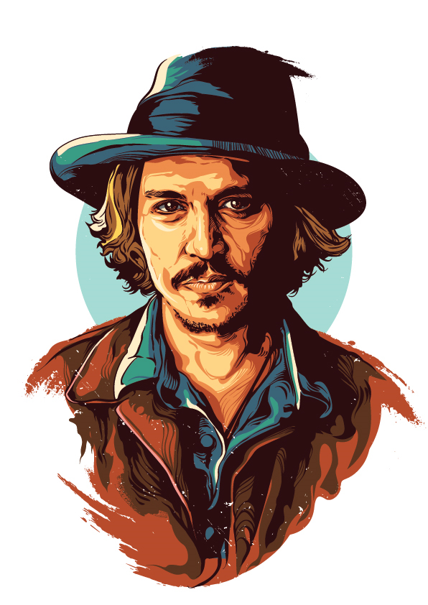
Founds his film production company
2004
Edward Scissorhands
Golden Globe for Best Actor
1990
2008
Johnny Depp is born
Donnie Brasco
Collaborates with Marilyn Manson
Jun 9, 1963
1997
2012
Learns to play the guitar
Fear and Loathing in Las Vegas
Forms band Hollywood Vampires
1975
1998
2015
A Nightmare on Elm Street
Pirates of the Caribbean 2
Pirates of the Caribbean 5
1984
2006
2017
1963
1963
1970
1977
1984
1991
1998
2005
2012
2018
1997
2007
Today
Jun 9, 2018
Directs The Brave
Pirates of the Caribbean 3
His 55th birthday
1993
2015
Benny and Joon
Marries Amber Heard
1989
2011
Gets engaged to Winona Rider
Pirates of the Caribbean 4
1979
2005
Drops out of high school
Charlie and the Chocolate Factory
2003
Pirates of the Caribbean 1

