Slide 1
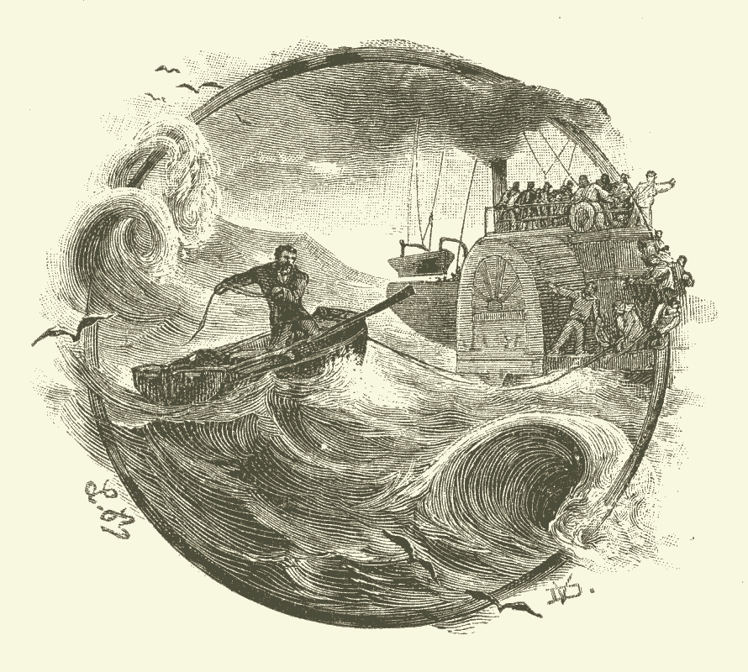
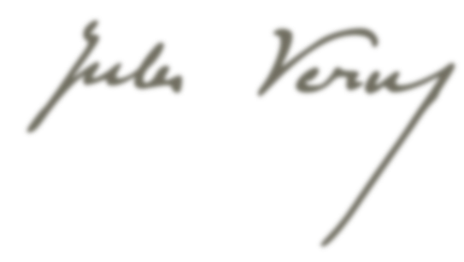
Broken Straws opens at Dumas's Théâtre historique
1850
Five Weeks in a Balloon
1863
Twenty Thousand Leagues under the Seas
1869
Sued for Plagiarism. Found innocent
1877
Moves to Paris to study law
From the Earth to the Moon
Shot by mentally disturbed nephew. Permanent limp
1847
1865
1886
Marries Honorine de Viane
Around the World in Eighty Days
Propeller Island
Dies of diabetes
1857
1872
1895
Mar 24, 1905
1828
1828
1836
1844
1852
1860
1868
1876
1884
1892
1900
1907
Today
1834
1851
1870
1880
1904
Enrolls at boarding school
First attack of facial paralysis
Becomes a deist
Travels to the North Sea and Scandinavia
Master of the world
Feb 8, 1828
1861
1874
1888
Jules Verne is born
Birth of Michel Verne
The Mysterious Island
Elected town councilor of Amiens
1849
1864
Meets Alexandre Dumas
Journey to the Center of the Earth

