Slide 1
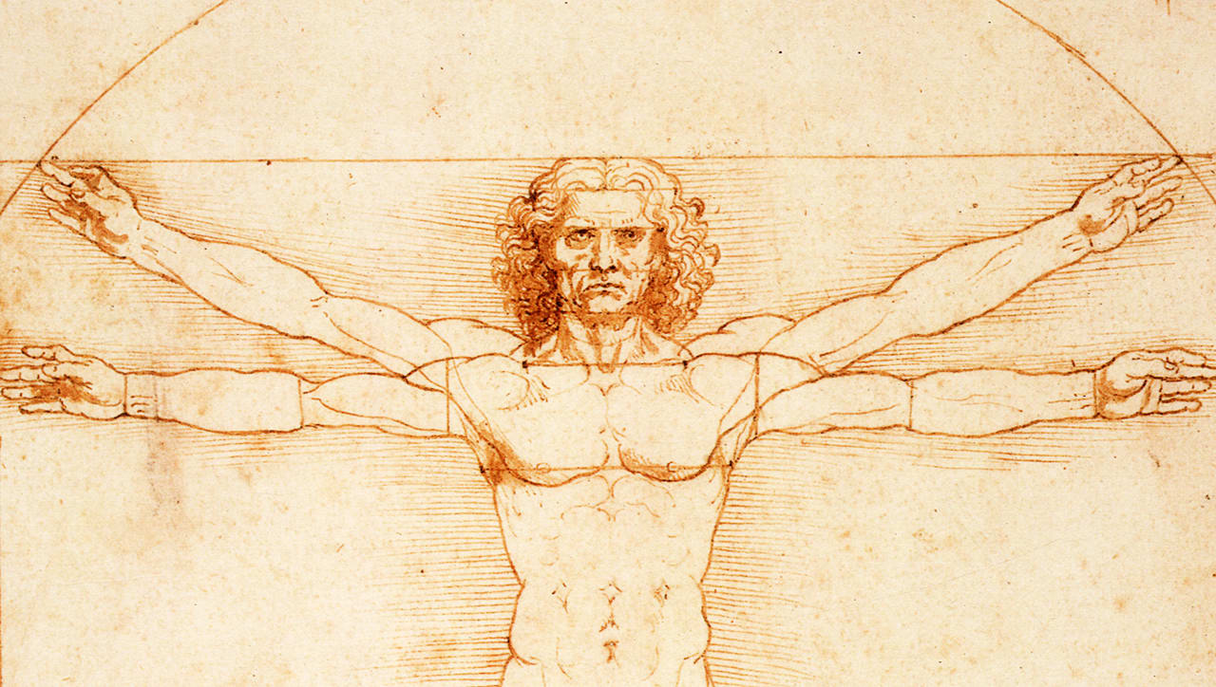

He is born in Tuscan town Vinci
15 Apr, 1452
Qualifies as independent master
Begins work as a military architect for Cesare Borgia
1478
1502
Begins work as an engineer for the Sforza clan in Milan
Moves to France, entering king Francis’ service
1484
1516
Starts apprenticeship with artist A. del Verrochio
Flees to Florence
1466
1499
Dies at Cloux
2 May, 1519
1452
1452
1459
1466
1473
1480
1487
1494
1501
1508
1515
1521
Today
1481
1495
The Adoration of the Magi
The Last Supper
1490
1516
The Vitruvian Man
St. John the Baptist
Life events
Most famous works
1486
1504
Virgin of the Rocks
La Gioconda (Mona Lisa)

