Slide 1
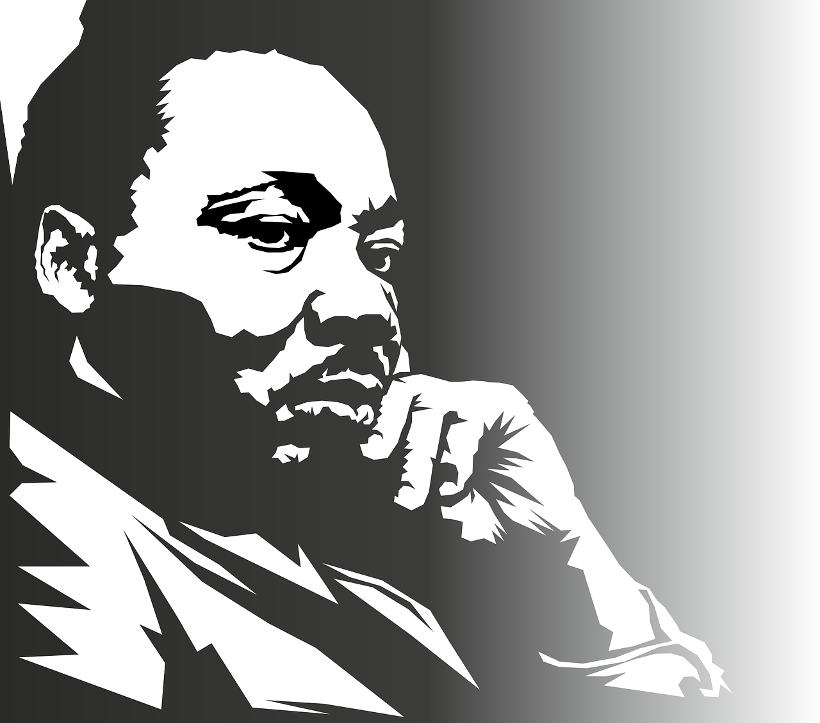

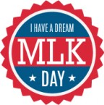

MLK's home is bombed during a speech; he urges against violent retaliation
Decries the unfair treatment of minorities in letter published by the Atlanta Constitution
January 30, 1956
Michael King (Martin Luther King Jr) is born in Atlanta, Georgia
June 08, 1946
Spends two weeks in prison to draw attention to the Albany movement
July 27, 1962
January 15, 1929
Earns Bachelor of divinity degree from Crozer
Publishes first book, "Stride Toward Freedom: The Montgomery Story"
June 08, 1951
Fatally shot on the balcony of Lorraine Motel, Memphis
September 17, 1958
April 09, 1968
Ordained by the Baptist Church
Named "Man of the Year" by Time magazine
February 25, 1948
January 03, 1964
1929
1929
1933
1937
1941
1945
1949
1953
1957
1961
1965
1968
September 14, 1953
Marries Coretta Scott
August 28, 1963
September 20, 1958
Delivers "I Have a Dream" speech
Stabbed and rushed to Harlem Hospital, New York
June 08, 1967
Announces the "Poor People's Campaign"
June 05, 1955
Awarded Doctorate in Systematic Theology, Boston University
April 10, 1968
The body of Martin Luther King Jr. laid to rest in Atlanta, Georgia
October 20, 1944
October 19, 1959
Enrolls in Morehouse College
Spends 8 days in prison; is released on a $2,000 bond
December 10, 1964
Receives the Nobel Peace Prize

