Slide 1


How to update this template in seconds
The Office Timeline add-in for PowerPoint will help you edit it with just a few clicks.
Get your free 14-day trial of Office Timeline here:
https://www.officetimeline.com/14-days-trial
Re-open this template, and create your impressive
PowerPoint visual in 3 easy steps:
1
Click the Edit Data button on the Office Timeline tab.
2
Use the Data and Timeline views to edit swimlanes, milestones and tasks.
3
Click Save to instantly update the template.

Slide 2













Bonus Timeline: How to Watch the MCU TV Shows (part 1)
CINEMATIC UNIVERSE
1946
2015
2017
2024
2025
2026
2027
Agent Carter (Season 1)
AC
Agent Carter (Season 2)
Agents of S.H.I.E.L.D (S1, Eps 1-7)
Agents of S.H.I.E.L.D (S3, Eps 1-19)
Agents of S.H.I.E.L.D (S5, Eps 11-18)
Agents of S.H.I.E.L.D (S1, Eps 17-22)
Agents of S.H.I.E.L.D (S5, S6, S7)
Agents of S.H.I.E.L.D (S2, Eps 20-22)
Agents of S.H.I.E.L.D (Season 4, Eps 9-22)
a
Agents of S.H.I.E.L.D (S1, Eps 1-10)
Agents of S.H.I.E.L.D (S2, Eps 11-19)
Agents of S.H.I.E.L.D (S4, Eps 1-6)
Agents of S.H.I.E.L.D (S3, Eps 20-22)
Agents of S.H.I.E.L.D (4, Eps 7-8)
Agents of S.H.I.E.L.D: Slingshot (S1, Eps 1-6)
Agents of S.H.I.E.L.D (S5, Eps 1-10)
Daredevil (S1)
Daredevil (S2, Eps 5-11)
Daredevil (Season 3)
d
Daredevil (S2, Eps 1-4)
Daredevil (S2, Eps 12-13)
IAG
I Am Groot (Season 1)
I Am Groot (Season 2)
J
Jessica Jones (Season 1)
Jessica Jones (Season 2)
Jessica Jones (Season 3)
Luke Cage (Season 1, Eps 1-4)
Luke Cage (Season 1, Eps 5-8)
C
Luke Cage (Season 1, Eps 9-13)
Luke Cage (Season 2)
I
Iron Fist (Season 1)
Iron Fist (Season 2)
The Punisher (Season 1)
The Punisher (Season 2)
c
Cloak & Dagger
IH
Inhumans (Season 1)
RA
Runaways (Season 1)
Runaways (Season 2)
Runaways (Season 3)

Slide 3





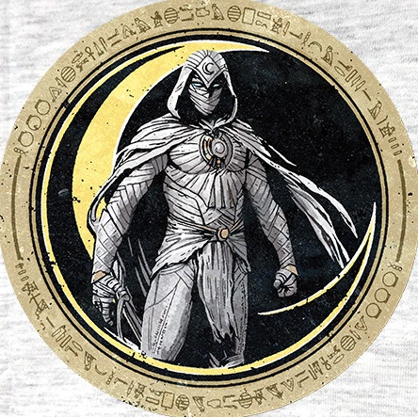



Bonus Timeline: How to Watch the MCU TV Shows (part 2)
CINEMATIC UNIVERSE
Jan
?
Feb
?
2023
2024
2026
Mar
Apr
May
Jun
Jul
Aug
Loki (S1&2) Outside Time
WI
What If...? (S1) - Multiverse
WV
Wandavision
HE
Hawkeye (S1)
FS
The Falcon and the Winter Soldier (S1)
MK
Moon Knight (S1)
SH
She-Hulk: Attorney at Law (S1)
MM
Ms. Marvel (S1)
SI
Secret Invasion (S1)

Slide 4















Timeline: How to Watch the Movies
CINEMATIC UNIVERSE
Ant-man and the Wasp
Avengers: Infinity War
Captain America: The First Avenger
Spider-Man: Far From Home
Captain America: Winter Soldier
Doctor Strange in the Multiverse of Madness
Iron Man 2
Guardians of the Galaxy Vol 2
Thor: Ragnarok
Black Panther: Wakanda Forever
The Avengers
Captain America: Civil War
Avengers:Endgame
Werewolf by night
Iron Man
Iron Man 3
Ant-Man
Black Widow
Eternals
Thor: Love and Thunder
The Marvels
1943
2026
Week 1
2
3
4
5
6
Thor
Guardians of the Galaxy
Spider-Man: Homecoming
Guardians of the Galaxy 3
Captain Marvel
Thor: The Dark World
Black Panther
Guardians of the Galaxy: HS
The Incredible Hulk
Doctor Strange
Ant-Man and the Wasp: Quantumania
Avengers: Age of Ultron
Spider-Man: No Way Home
Shang-Chi and the Legend of the Ten Rings

