Slide 1
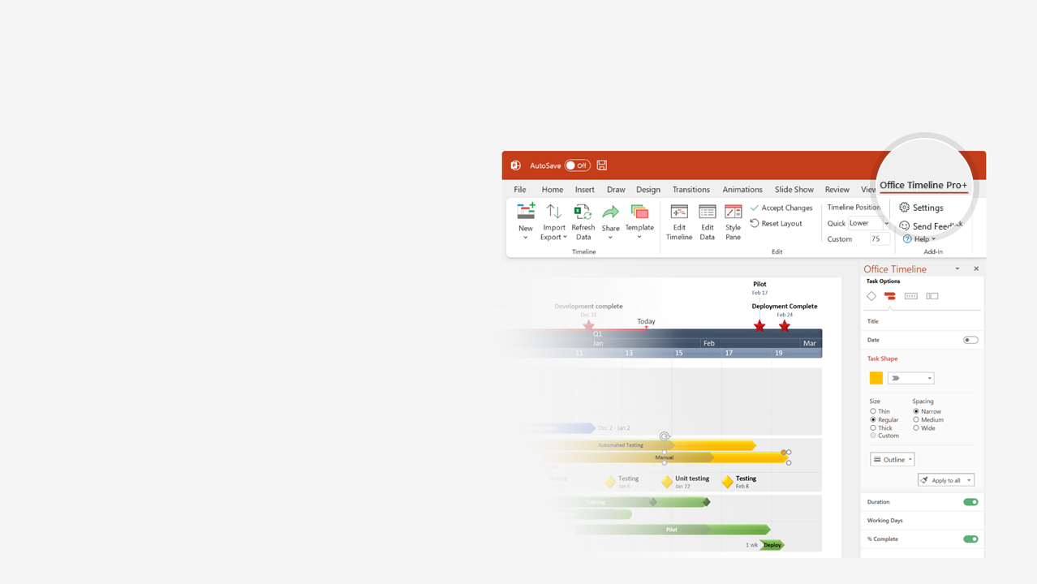

How to update this template in seconds
The Office Timeline add-in for PowerPoint will help you edit it with just a few clicks.
Get your free 14-day trial of Office Timeline here: https://www.officetimeline.com/14-days-trial Re-open this template, and create your impressive PowerPoint visual in 3 easy steps:
1
Click the Edit Data button on the Office Timeline tab.
2
Use the Data and Timeline views to edit swimlanes, milestones and tasks.
3
Click Save to instantly update the template.

Slide 2

Gap analysis
Objective | Current state (FROM) | Desired State (TO) | Gaps | Remedies
Innovation | We are not currently known for innovation. However, our software does have some unique features. | To be recognized as among the top 5 innovative products in the industry (according to Gartner). | 40% Only 10% of our developer resources are working on new features. | Our goals is to increase that to 50%. We need to hire at least 6 more developers.
Accessibility | Our software only has a desktop version. | To have our software easily accessible by anyone. | Not compatible with online platforms. | Create a web version of the application.
Item | Add statement of the current progress of the product. | Add statement about the desired state. | Add identified gaps. | Discuss with your team and figure out what remedies can be applied.
Action plan
Q1 Review
Q2 Review
Q3 Review
Q4 Review
Q1
Q2
Q3
Q4
Milestone
Item 1
Initiative
Activity
Initiative
Initiative
Initiative
Initiative
Activity
Activity
Initiative
Item 2
Initiative
Initiative
Initiative
Item 3
Activity
Activity
Activity
Activity

