Slide 1
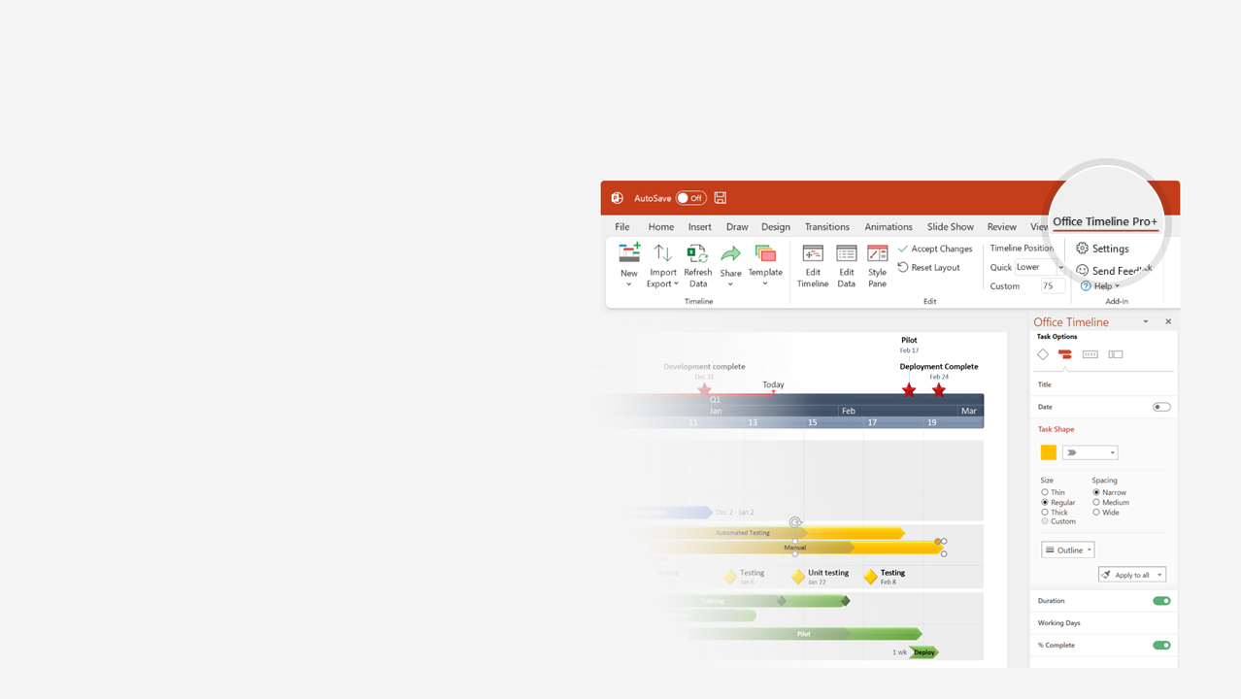

How to update this template in seconds
The Office Timeline add-in for PowerPoint will help you edit it with just a few clicks.
Get your free 14-day trial of Office Timeline here: https://www.officetimeline.com/14-days-trial Re-open this template, and create your impressive PowerPoint visual in 3 easy steps:
1
Click the Edit Data button on the Office Timeline tab.
2
Use the Data and Timeline views to edit swimlanes, milestones and tasks.
3
Click Save to instantly update the template.

Slide 2

MEMORIAL DAY
HISTORY TIMELINE
First attestation of the name "Memorial Day"
Early commemorations after the Civil War
Poppy adopted as symbol of reference
National Moment of Remembrance set up
1882
Established on the last Monday of May
1865
1920
1971
2000
1865
1882
1899
1916
1933
1950
1967
1984
May 30, 1868
1890
1922
1967
First observed as "Decoration Day"
Adopted by Northern states
Lincoln Memorial dedicated
"Memorial Day" declared official name
Made with

