Slide 1
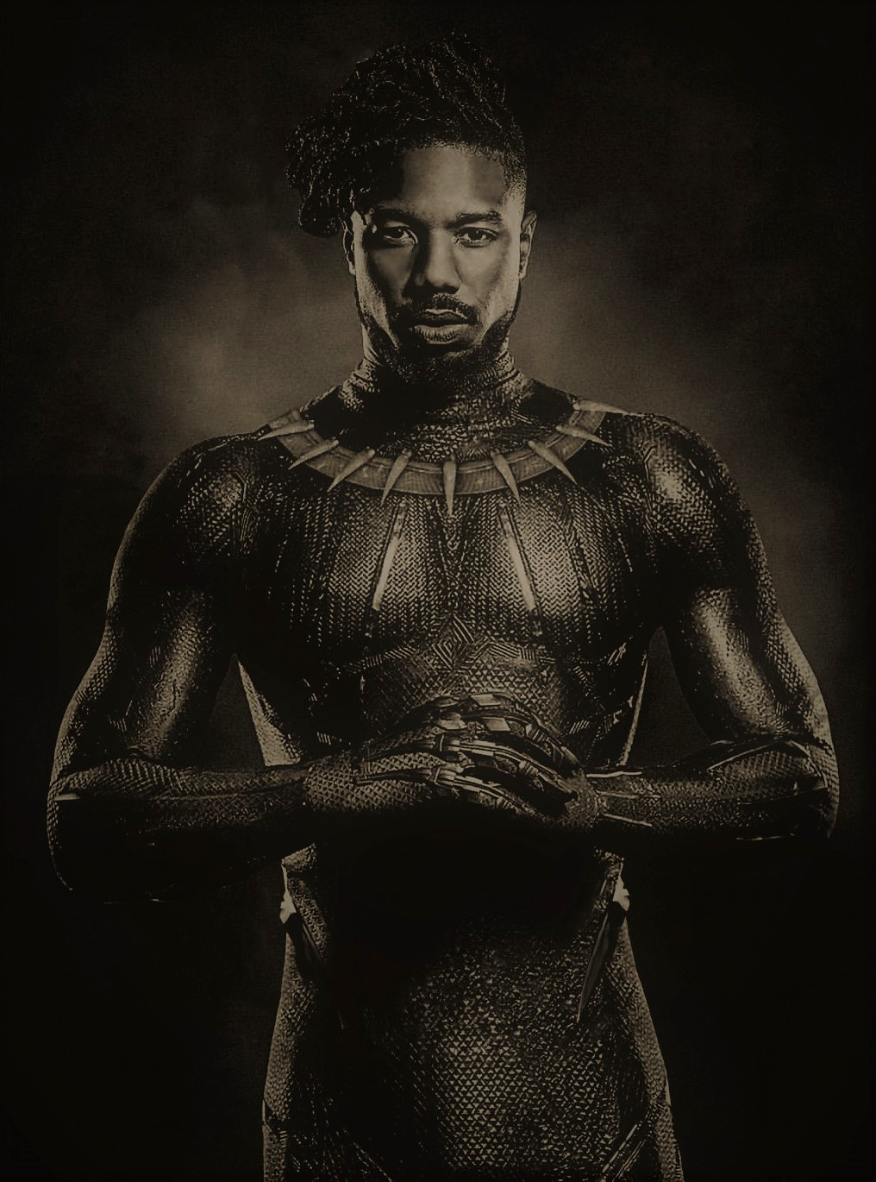
Breakthrough Performance Satellite Award
2013
African-American Film Critics Association Award
2014
All My Children
Cold Case
Fantastic Four
2003
2007
2015
Debut role in TV series The Sopranos & Cosby
Lie to Me
Black Panther
1999
2010
2018
1987
1987
1990
1993
1996
1999
2002
2005
2008
2011
2014
2017
2019
Feb 9, 1987
2002
2006
2009
2012
2015
Today
Michael Bakari Jordan is born
Feb 9, 2019
The Wire
CSI Miami
Bones
Chronicle
Creed
His 32nd birthday
2018
Teen Choice Awards
2016
National Society of Film Critics Award
2013
Fruitvale Station (breakthrough role)

