Slide 1


How to update this template in seconds
The Office Timeline add-in for PowerPoint will help you edit it with just a few clicks.
Get your free 14-day trial of Office Timeline here:
https://www.officetimeline.com/14-days-trial
Re-open this template, and create your impressive
PowerPoint visual in 3 easy steps:
1
Click the Edit Data button on the Office Timeline tab.
2
Use the Data and Timeline views to edit swimlanes, milestones and tasks.
3
Click Save to instantly update the template.

Slide 2
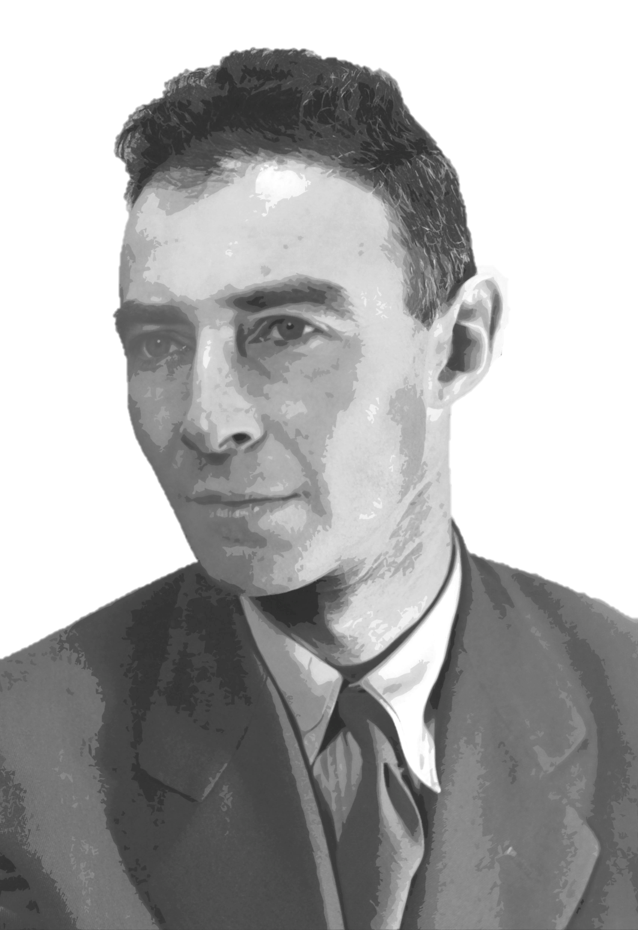

J. ROBERT OPPENHEIMER
TIMELINE
Graduates from Harvard
Trinity test of the atomic bomb
1925
July 16, 1945
Security
clearance
revoked
Is born in New York City
Earns his doctorate in Physics
(University of Göttingen)
Full professor
at UC Berkley
Bombings of Hiroshima
and Nagasaki
Passes away in Princeton,
aged 62
April 22, 1904
1927
1936
1945
1953
February 18, 1967
1904
1912
1920
1928
1936
1944
1952
1960
1967
At 12 y.o., delivers lecture at the New York Mineralogical Club
Graduates from the Ethical Culture School of New York
Early career
1916
1921
Begins work at Cavendish Laboratory, Cambridge
Moves from Cambridge to the University of Göttingen
1925
1926
Becomes involved with Jean Tatlock
Marries Katherine ("Kitty") Puening
1936
1940
Personal Life
Son, Peter, is born
Daughter, Katherine ("Toni"), is born
1941
1944
Jean Tatlock takes her own life
1944
Is recruited to work on the Manhattan Project
Appointed as director of the Manhattan Project
Manhattan Project
1942
1943
Receives the Presidential Medal of Merit
1946
Accepts a position at CalTech
Director of Institute for Advanced Study - Princeton
Postwar activities
1945
1947
Chairman of the General Advisory Committee of the U.S. AEC
1947
Officer of the Legion of Honor (France)
1957
Final years
Receives the Enrico Fermi Award
1963
Foreign Member of the Royal Society
1962

