Slide 1
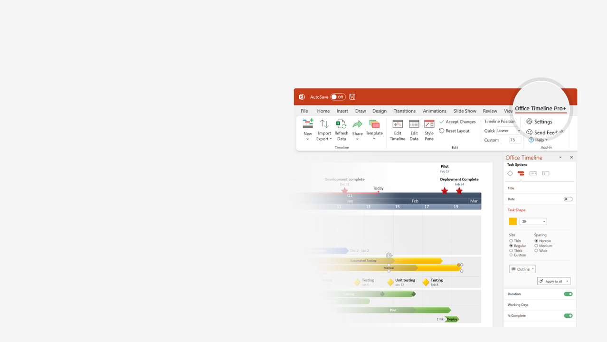

How to update this template in seconds
The Office Timeline add-in for PowerPoint will help you edit it with just a few clicks.
Get your free 14-day trial of Office Timeline here:
https://www.officetimeline.com/14-days-trial
Re-open this template, and create your impressive
PowerPoint visual in 3 easy steps:
1
Click the Edit Data button on the Office Timeline tab.
2
Use the Data and Timeline views to edit swimlanes, milestones and tasks.
3
Click Save to instantly update the template.

Slide 2


Project Management Conferences 2024
Q1
Q2
Q3
Q4
2024
Jan
Feb
Mar
Apr
May
Jun
Jul
Aug
Sep
Oct
Nov
Dec
PMBA
Apr 22 - Apr 24
Orlando
May 6 - May 8
Washington
CHG MGMT
Feb 29 - Mar 2
San Diego
Jun 11 - Jun 13
Virtual Conference
RPS
Jun 11 - Jun 14
TBD
GSG 2024
May 19 - May 22
New Orleans
United States
Feb 27 - Feb 28
Orlando
Jun 10 - Jun 11
Denver
Dec 4 - Dec 5
Dallas
Digital Summit
Mar 13 - Mar 14
Las Vegas
Aug 14 - Aug 15
Minneapolis
Apr 3 - Apr 4
Chicago
Aug 14 - Aug 15
Dallas
Apr 25 - Apr 26
New York
IPMA
Apr 19 - Apr 21
Maryland
Agile 2024
Jul 22 - Jul 26
Dallas
PMI Global Summit
Sep 18 - Sep 21
Los Angeles
Canada
PMBA
Mar 25 - Mar 28
Toronto
House of PMO
Jun 18 - Jun 19
London
UK
Future PMO
Oct 3
London
AIPM
Mar 24 - Mar 27
TBD
Australia
Aug 13 - Aug 15
Canberra
PGCS
Online
PMS Symposium
Apr 18 - Apr 19
UMD / Online / Hybrid
Germany
PMI Global Summit
Apr 10 - Apr 11
Berlin
Africa
PMI Global Summit
Oct 3 - Oct 10
TBD (Rwanda)
South America
ICPM
Sep 5 - Sep 6
Bogotá, Colombia

