Slide 1
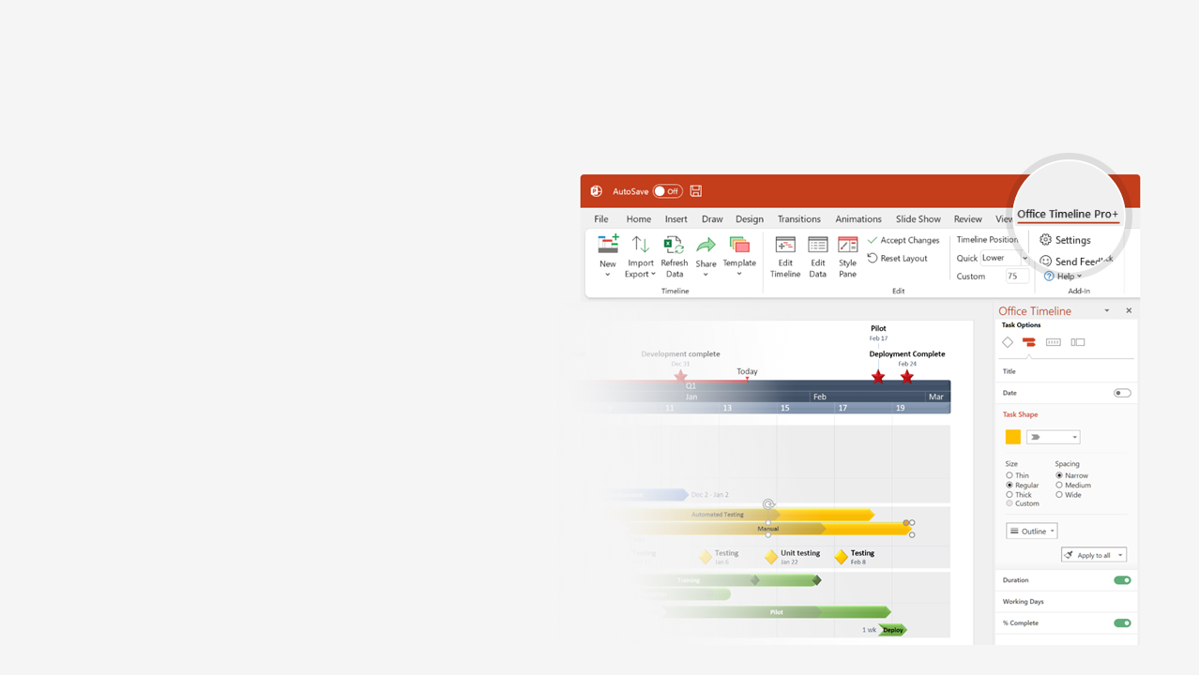

How to update this template in seconds
The Office Timeline add-in for PowerPoint will help you edit it with just a few clicks.
Get your free 14-day trial of Office Timeline here:
https://www.officetimeline.com/14-days-trial
Re-open this template, and create your impressive
PowerPoint visual in 3 easy steps:
1
Click the Edit Data button on the Office Timeline tab.
2
Use the Data and Timeline views to edit swimlanes, milestones and tasks.
3
Click Save to instantly update the template.

Slide 2

Software Development Methodologies timeline
1968
1972
1976
1980
1984
1988
1992
1996
2000
2004
2008
2012
Rapid Application Development (RAD)
Extreme Programming (XP)
Large-Scale-Scrum (LeSS)
1990
1999
2013
Scrum
Disciplined Agile Delivery (DAD)
Agile
1995
2008
Dynamic Systems Development Method (DSDM)
Scaled Agile Framework (SAFe)
1994
2011
Agile Unified Process (AUP)
2005
Structured Programming Paradigm
Soft Systems Methodology (SSM)
Structured
1985
1968
Software Engineering
Rational Unified Process (RUP)
Unified Software Development Process (USDP)
1998
1999
Object Oriented
Object-oriented programming (OOP)
1992
Cap Gemini System Development Methodology (SDM)
Waterfall
1974
Structured Systems Analysis and Design Method (SSADM)
1980
Team
Team Software Process (TSP)
1998

