Slide 1
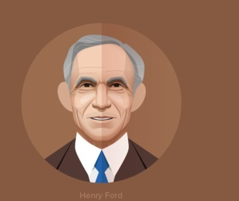
Introduces Model T
1908
Establishes the Henry Ford Company
Honored by the Smithsonian Institution
1901
1932
Designs & builds the Ford Quadricycle
Introduces a reduced workweek for employees
1896
1926
Henry Ford is born
Marries Clara Jane Bryant
Runs as a Democrat for the US Senate
Retires, ceding his company to his grandson
Jul 30, 1863
1888
1918
1945
1863
1863
1871
1879
1887
1895
1903
1911
1919
1927
1935
1943
1950
Today
1879
1903
1927
Apr 7, 1947
Leaves home to work as an apprentice machinist
Creates the Ford Motor Company
Introduces Ford Model A
Dies of cerebral hemorrhage
1934
Produces half of the planes used by US in WWII
1918
Enters the aviation business
1915
Funds pacifist organisation Peace Ship
1901
Designs & builds 26hp automobile
1899
Founds the Detroit Automobile Company
1891
Becomes engineer for Edison Illuminating Co.

