Slide 1
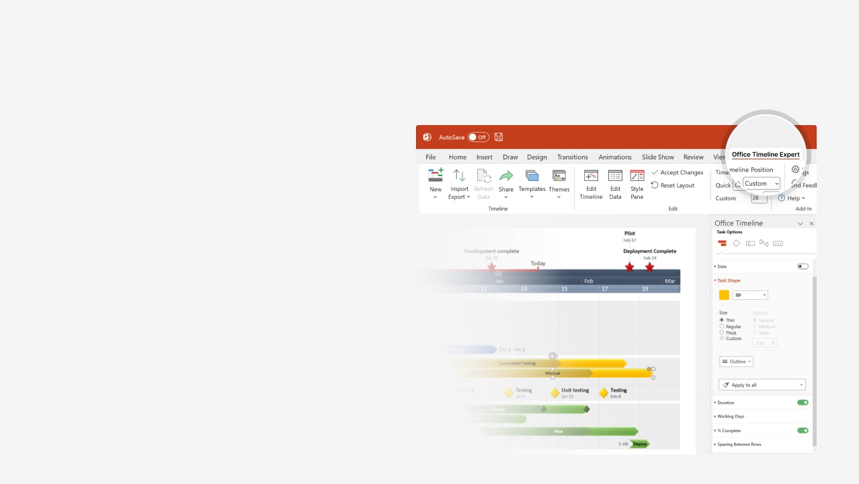

How to update this template in seconds
The Office Timeline add-in for PowerPoint will help you edit it with just a few clicks.
Get your free 14-day trial of Office Timeline here:
https://www.officetimeline.com/office-timeline/14-days-trial
Re-open this template, and create your impressive
PowerPoint visual in 3 easy steps:
1
Click the Edit Data button on the Office Timeline tab.
2
Use the Data and Timeline views to edit swimlanes, milestones and tasks.
3
Click Save to instantly update the template.

Slide 2








2006
2025
Today
Office Timeline
@officetimeline
Check out this timeline of the history of Twitter – X #twitter #X #officetimeline
Musk buys Twitter, fires Agrawal
Oct 2022
Official launch of Twitter
Twitter goes public
New CEO
Parag Agrawal
Rebranding
to "X"
Jul 2006
Nov 2013
Jack Dorsey becomes
permanent CEO
Nov 2021
Nov 2023
The first tweet
CEO transition
CEO change
Twitter goes private
Mar 2006
May 2008
Oct 2010
Oct 2015
Nov 2022
2006
2008
2010
2012
2014
2016
2018
2020
2022
2024
SXSW
Award
Popularity surge
high-profile users
Acquisition
of Vine
Jack Dorsey
Returns as CEO
Character limit
expansion
Ban on political
advertising
Spaces
Photo sharing
Twitter Blue
Mar 2007
Feb 2009
Jun 2011
Oct 2012
Jun 2015
Nov 2017
Oct 2019
Mar 2021
Jan 2023
Gnip
Moments
Violent accounts
suspended
Fleets
Musk
top
shareholder
Negative
cash
flow
Jan 2014
Mar 2016
Nov 2020
Aug 2018
Apr 2022
Jul 2023
Series B
funding
Promoted
Tweets
140 M monthly
active users
Partnership
with NFL
Fleets
shutdown
611 M monthly
active users
Jul 2008
Apr 2010
Mar 2012
Apr 2016
Jun 2021
May 2024
Redesigned
website
Acquisition of
Revue
Jun 2019
Apr 2021
Number of
Tweets grows
Role in Iranian
protests
Activity & Discover
Analytics
dashboard
New rules
against harassment
High-profile
account hack
New verification
system
Dec 2011
Apr 2007
Jun 2009
Jul 2014
Dec 2017
Jul 2020
Mar 2023
43
2.3K
10K
105K

