Slide 1
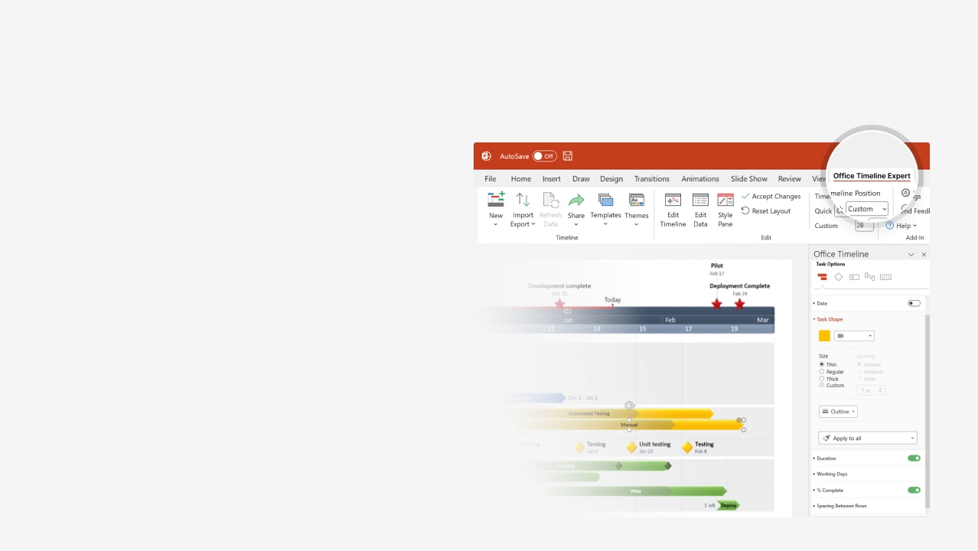

How to update this template in seconds
The Office Timeline add-in for PowerPoint will help you edit it with just a few clicks.
Get your free 14-day trial of Office Timeline here:
https://www.officetimeline.com/office-timeline/14-days-trial
Re-open this template, and create your impressive
PowerPoint visual in 3 easy steps:
1
Click the Edit Data button on the Office Timeline tab.
2
Use the Data and Timeline views to edit swimlanes, milestones and tasks.
3
Click Save to instantly update the template.

Slide 2

Online Banking Platform Implementation
2025
2026
Apr
May
Jun
Jul
Aug
Sep
Oct
Nov
Dec
Jan
Feb
Mar
3
5
7
9
11
13
15
17
19
21
23
25
27
29
31
33
35
37
39
41
43
45
47
49
51
Project initiation and planning
4/25 - 6/25
PHASE 1 -
Project
initiation and planning
PMO, Senior management, BA, all relevant
Estimate ROI
Initial budget
Communication plan
Risk assessment
Project scope
Feasibility study
Requirements gathering
Project plan development
System design and development
6/25 - 10/25
System architecture design
PHASE 2 -
System design and development
IT, External security consultants
Development (dev & testing)
Integration testing
Security and penetration testing
Security audit
12/25
Go-live
Testing and deployment
10/25 - 1/26
PHASE 3 -
Testing and deployment
IT, QA, Marketing
User acceptance testing (UAT)
Performance testing
Deployment and go-live
User training
Post-implementation review
PHASE 4 -
Maintenance
12/25 - 3/26
Maintenance and support
IT support
System optimization
Knowledge transfer

Slide 3
New Investment Product Launch
Official fund launch & public announcement
Today
10/25
Jan
Feb
Mar
Apr
May
Jun
Jul
Aug
Sep
Oct
Nov
Dec
Market analysis
Stakeholder meeting
2/25
Research & development
1/25 - 2/25
Conduct market research & competitive analysis
2/25 - 3/25
Define fund strategy & investment criteria
Product development
Test financial model assumptions
3/25
3/25 - 4/25
Develop financial model & projections
Legal structuring & regulatory approvals
Review legal
options
Internal
review
Legal & compliance
3/25
4/25
2/25 - 4/25
Select legal structure
& draft fund documents
File regulatory applications
& obtain approvals
4/25 - 7/25
Marketing strategy
Develop marketing materials & investor presentation
4/25 - 5/25
Marketing & sales
Prepare investor pitch
Track investor feedback
Investor relations
7/25
8/25
7/25 - 9/25
Roadshow
& investor meetings
Fund setup
Establish fund operations & infrastructure
7/25 - 8/25
Operations
Evaluate returns
Update investors
Portfolio acquisition
12/25
Begin initial investments
9/25 - 12/25

Slide 4
Private Equity Transaction
Mar
Apr
May
Jun
Jul
Aug
Sep
Oct
Nov
Dec
Jan
Feb
Mar
Apr
May
Jun
Jul
3
5
7
9
11
13
15
17
19
21
23
25
27
29
31
33
35
37
39
41
43
45
47
49
51
53
55
57
59
61
63
65
67
69
71
73
Feb 24 - Mar 14
Teaser sent by bankers
Marketing
Mar 15 - Mar 25
NDA signed
Mar 26 - Apr 24
CIM sent by bankers
Apr 25 - May 6
Calls with management team
Jun 6 - Jul 16
Expression of interest / non-binding offer
Jul 17 - Sep 15
Financial model and valuation
Sep 16 - Sep 25
Data room access granted
Valuation & due diligence
Sep 26 - Oct 7
In-person meeting with management
Oct 8 - Oct 28
Letter of intent
Oct 29 - Jan 15
Exclusivity period and final due diligence
Dec 20 - Jan 28
Quality of earnings report
Dec 21 - Jan 8
Final bid/offer submitted
Jan 9 - Mar 30
Definitive agreements: SPA / APA
Feb 18 - Mar 30
Shareholders’ agreement and other agreements
Negotiations & closing
Feb 11 - Apr 10
Financing secured
Regulatory approvals
Apr 11 - Jun 29
Closing
Jun 30 - Jul 20

