Slide 1
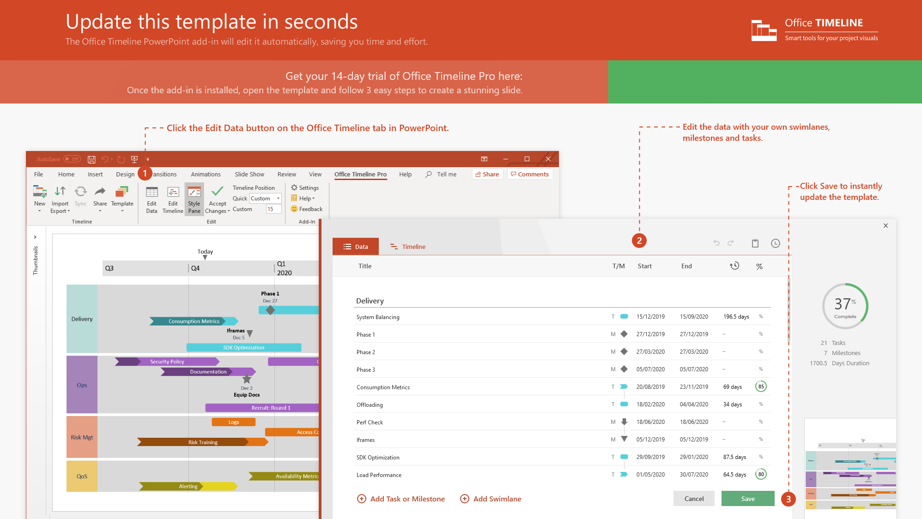
https://www.officetimeline.com/14-days-trial

Slide 2
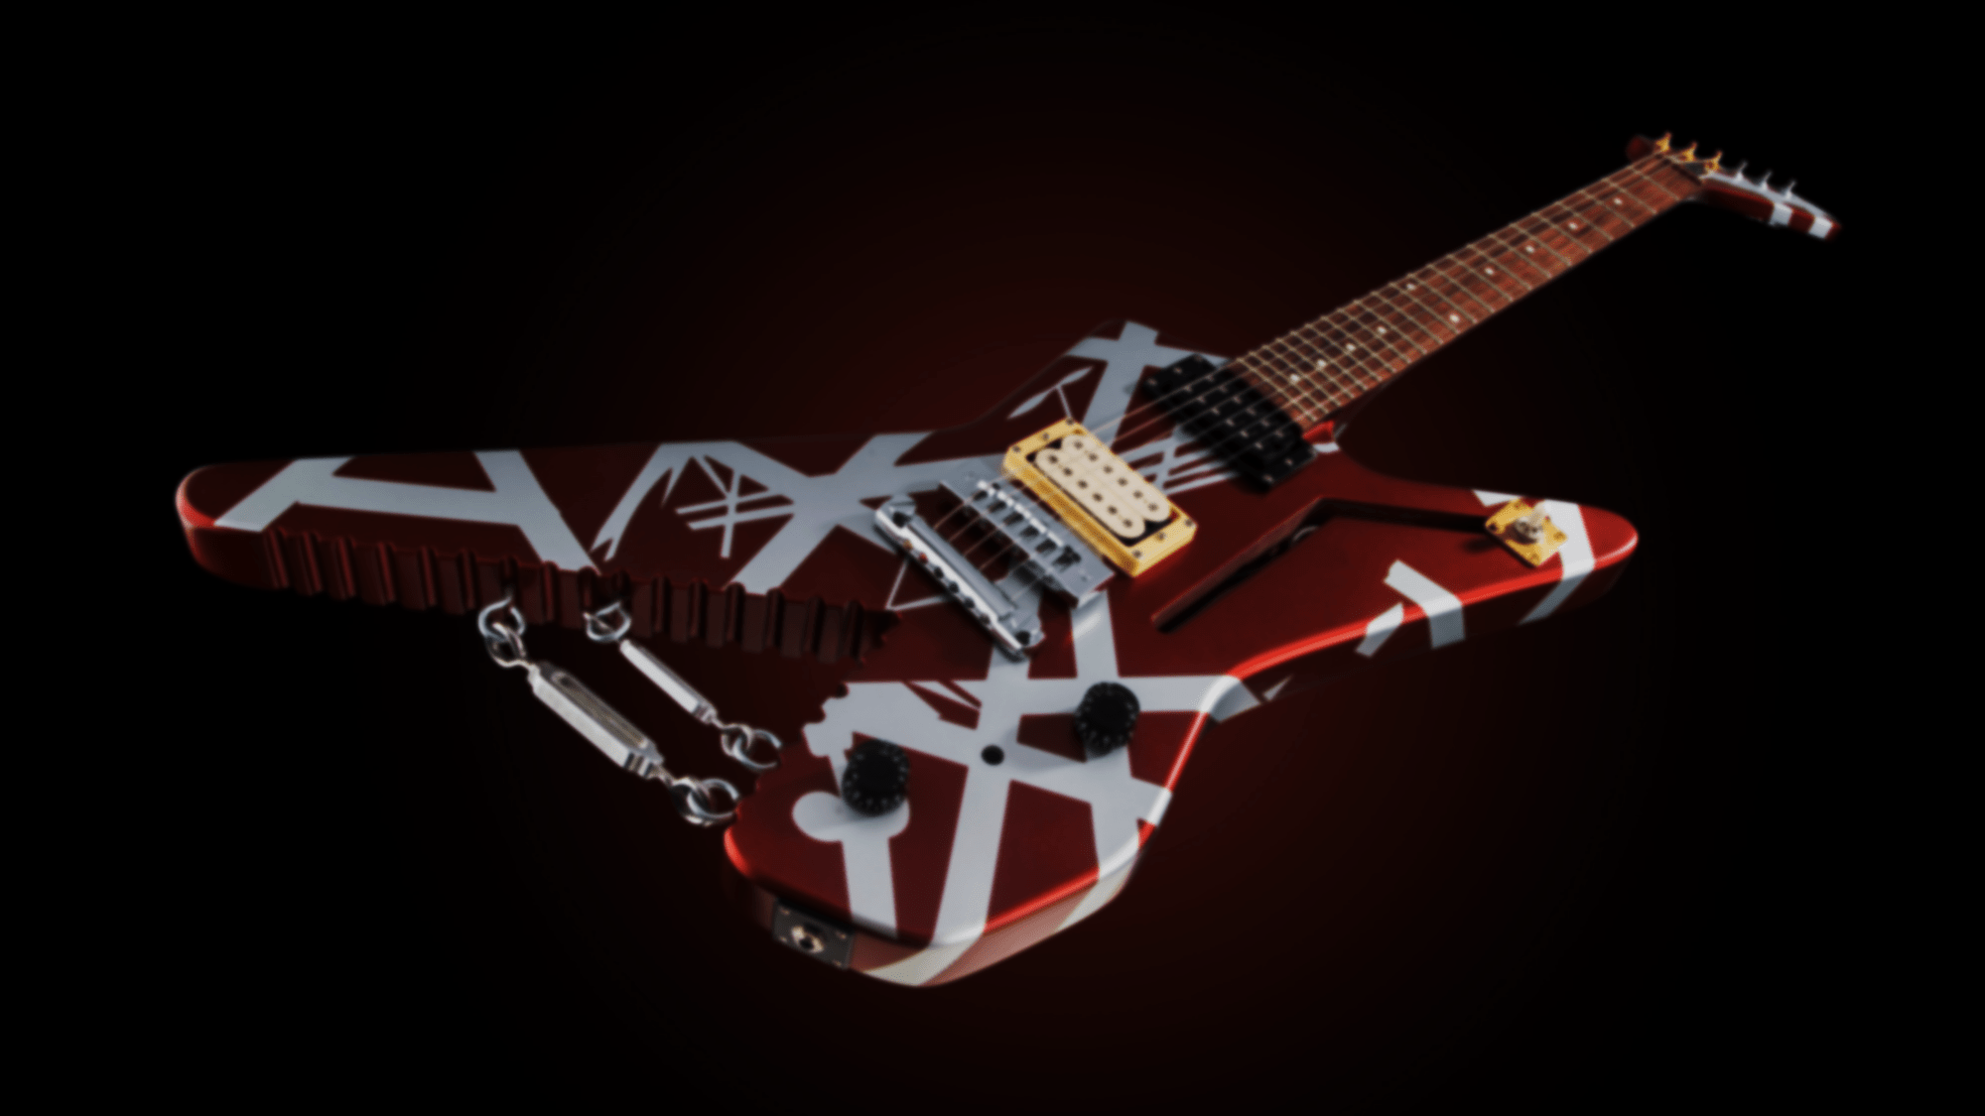
Forms band "Mammoth" with brother Alex
Marries actress and stuntwoman Janie Liszewski
1972
2009
Band Wins Grammy for Best Hard Rock Performance
1992
Divorce from Valerie Bertinelli is finalized
Offered recording deal by Warner
2007
Born in Amsterdam to Jan and Eugenia Van Halen (née van Beers)
1977
Is inducted into Rock and Roll Hall of Fame
1955
2007
Mammoth is renamed Van Halen
1974
Loses battle with throat cancer, Santa Monica, CA
2020
1952
1958
1964
1970
1976
1982
1988
1994
2000
2006
2012
2018
1962
2012
Family moves to Pasadena, CA
Undergoes emergency surgery for diverculitis
2000
1971
Starts treatment for tongue cancer
Invents "tapping" guitar solo technique
2007
1980
Enters rehab for alcoholism and drug abuse
Marries actress Valerie Bertinelli

Slide 3
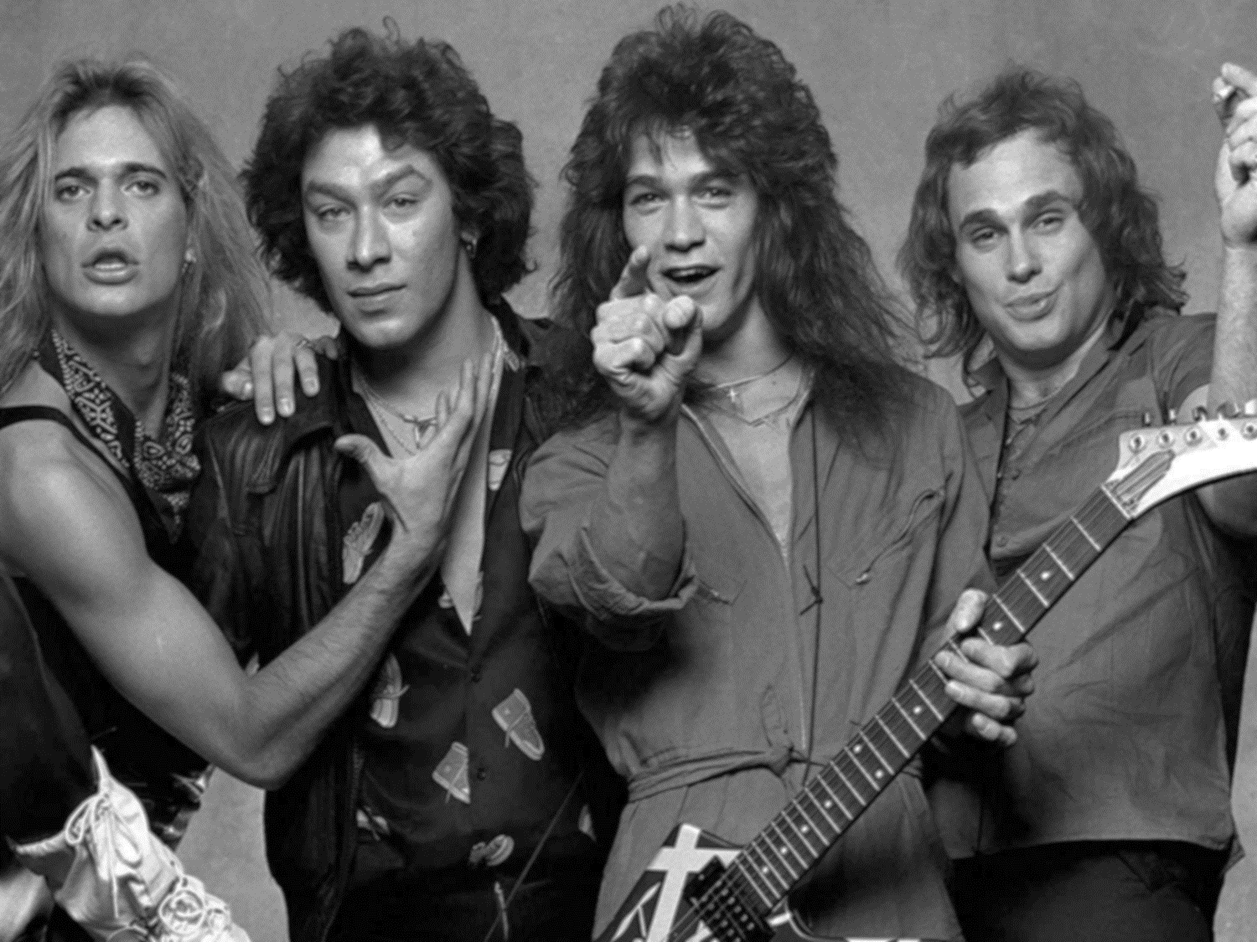
Women and Children First
A Different Kind of Truth
1980
2012
For Unlawful Carnal Knowledge
Diver Down
1991
1982
Van Halen
1978
1976
1980
1984
1988
1992
1996
2000
2004
2008
2012
1979
1984
Van Halen II
1984
1995
Live: Right Here, Right Now
1988
1981
OU812
Fair Warning
1986
1998
5150
Van Halen III

