Slide 1
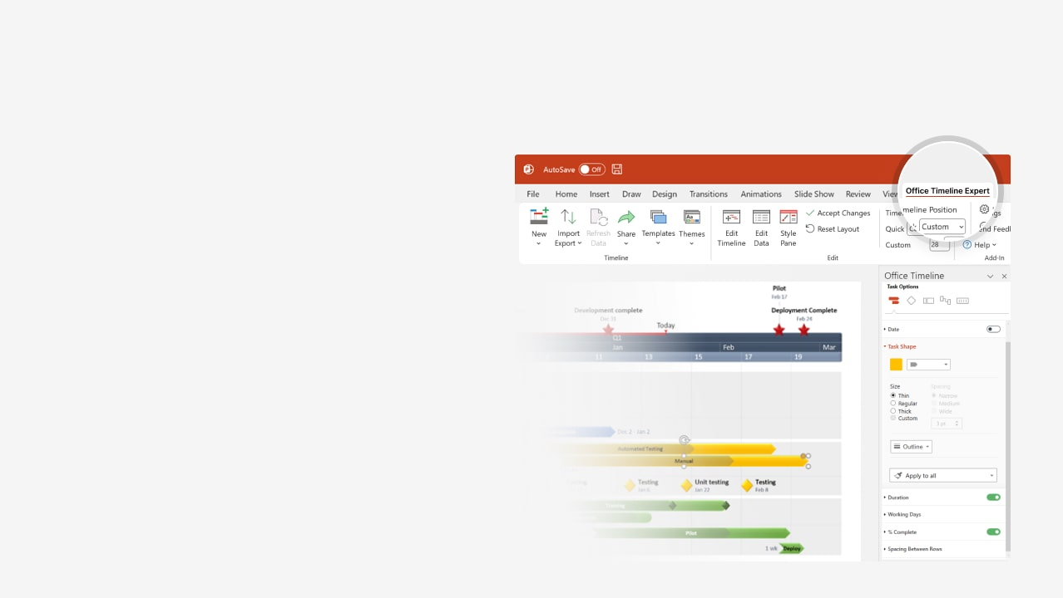

How to update this template in seconds
The Office Timeline add-in for PowerPoint will help you edit it with just a few clicks.
Get your free 14-day trial of Office Timeline here:
https://www.officetimeline.com/office-timeline/14-days-trial
Re-open this template, and create your impressive
PowerPoint visual in 3 easy steps:
1
Click the Edit Data button on the Office Timeline tab.
2
Use the Data and Timeline views to edit swimlanes, milestones and tasks.
3
Click Save to instantly update the template.

Slide 2

38 days
15 days
30 days
16 days
14 days
18 days
2025
2025
Today
Project Schedule Template
Project Initiation
Project Audit
Project Closure
Aug 8
Oct 4
Dec 8
Q3
Q4
Aug
Sep
Oct
Nov
Dec
Day 1
15
29
43
57
71
85
99
113
Aug 13 - Oct 4
Task 1 Here
Team 1
Milestone 1
Milestone 3
Phase 1
Aug 13
Oct 4
Milestone 2
Team 2
Aug 16 - Sep 5
Sep 5
Task 2 Here
Milestone 4
Team 1
Oct 21
Oct 4 - Nov 16
Task 3 Here
Oct 4 - Oct 27
Nov 8 - Nov 27
Task 4 Here
Task 5 Here
Team 2
Milestone 5
Milestone 6
Phase 2
Oct 28
Nov 27
Nov 12 - Dec 7
Task 6 Here
Team 3
Milestone 7
Milestone 8
Nov 12
Nov 30

