Slide 1
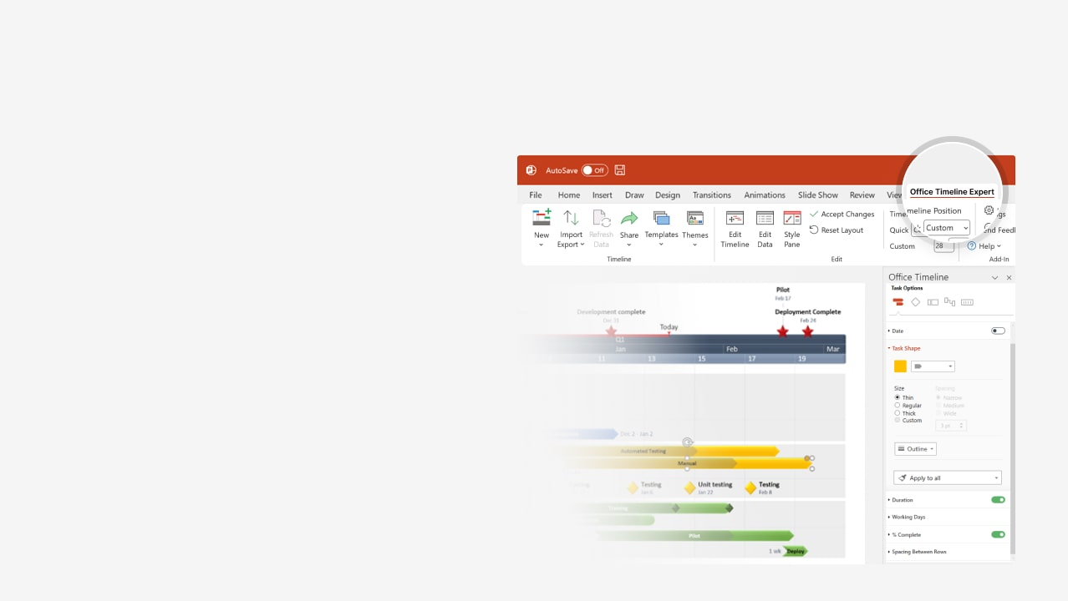

How to update this template in seconds
The Office Timeline add-in for PowerPoint will help you edit it with just a few clicks.
Get your free 14-day trial of Office Timeline here: https://www.officetimeline.com/office-timeline/14-days-trial Re-open this template, and create your impressive PowerPoint visual in 3 easy steps:
1
Click the Edit Data button on the Office Timeline tab.
2
Use the Data and Timeline views to edit swimlanes, milestones and tasks.
3
Click Save to instantly update the template.

Slide 2

Graphic chart timeline
Milestone and resource planning
Beta test 1.2 rollout, documentation and usability feedback
Final project checkpoint and close
Project approval and kickoff
Production cost study
Beta Test 2.2
Aug 11
Sep 2
Sep 23
Oct 22
Nov 12
Nov 29
2025
Week 1
3
5
7
9
11
13
15
2025
Today
Aug 27
Oct 8
Nov 23
SEO research, marketing analysis and business planning
Develop stage 1 funding plan and approval
Develop stage 2 program and certification process

