Slide 1
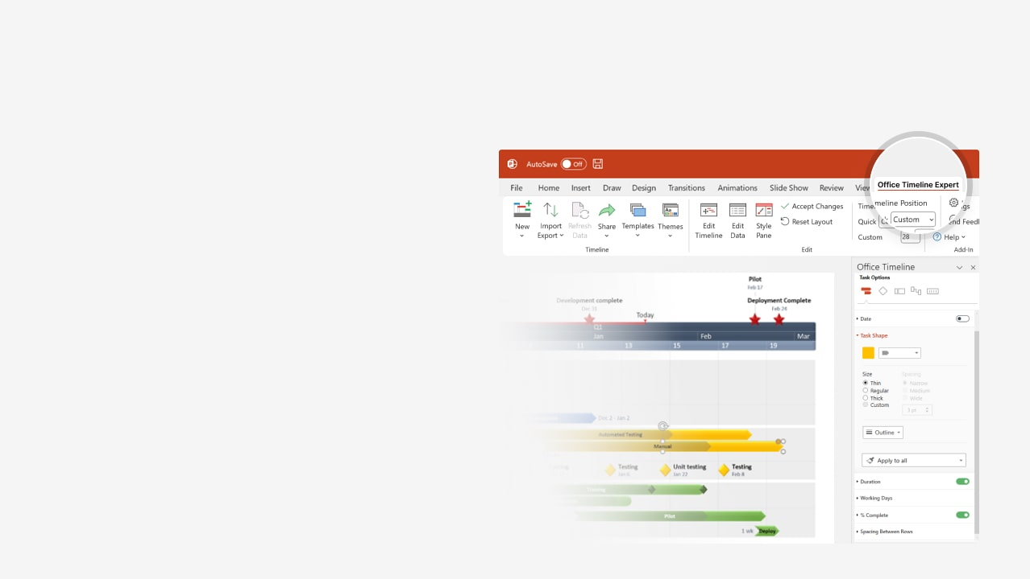

How to update this template in seconds
The Office Timeline add-in for PowerPoint will help you edit it with just a few clicks.
Get your free 14-day trial of Office Timeline here: https://www.officetimeline.com/office-timeline/14-days-trial Re-open this template, and create your impressive PowerPoint visual in 3 easy steps:
1
Click the Edit Data button on the Office Timeline tab.
2
Use the Data and Timeline views to edit swimlanes, milestones and tasks.
3
Click Save to instantly update the template.

Slide 2

Incident Response Timeline
Average response from detection to remedy
Incident Report
Incident Verified
Response Identified & Dispatched
Response Arrives
Incident Occurs
Incident Cleared
Operations Resume
Health check
Health check
Hour 1
2
Detection
Verification
Response
Remedy
9 mins
10 mins
10 mins
11 mins
Incident Duration Total
Remedy Validation
40 mins
35 mins
Return to Normal Flow

