Slide 1
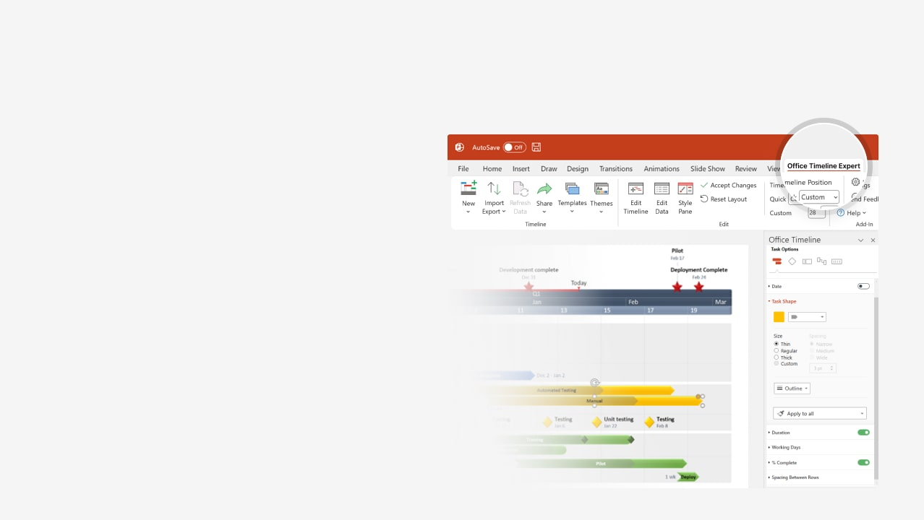

How to update this template in seconds
The Office Timeline add-in for PowerPoint will help you edit it with just a few clicks.
Get your free 14-day trial of Office Timeline here:
https://www.officetimeline.com/office-timeline/14-days-trial
Re-open this template, and create your impressive
PowerPoint visual in 3 easy steps:
1
Click the Edit Data button on the Office Timeline tab.
2
Use the Data and Timeline views to edit swimlanes, milestones and tasks.
3
Click Save to instantly update the template.

Slide 2

Project To Do List
Milestone 1
Milestone 2
Milestone 3
Milestone 4
Milestone 5
Jan 15
Apr 15
Jun 10
Aug 11
Nov 30
Jan
Feb
Mar
Apr
May
Jun
Jul
Aug
Sep
Oct
Nov
Today
1/15 - 4/30
Task 1
77 days
3/30 - 4/30
Task 2
22 days
4/15 - 6/30
Task 3
55 days
4/15 - 6/30
Task 4
55 days
6/29 - 11/3
Task 5
90 days
10/15 - 11/30
Task 6
34 days

