Slide 1
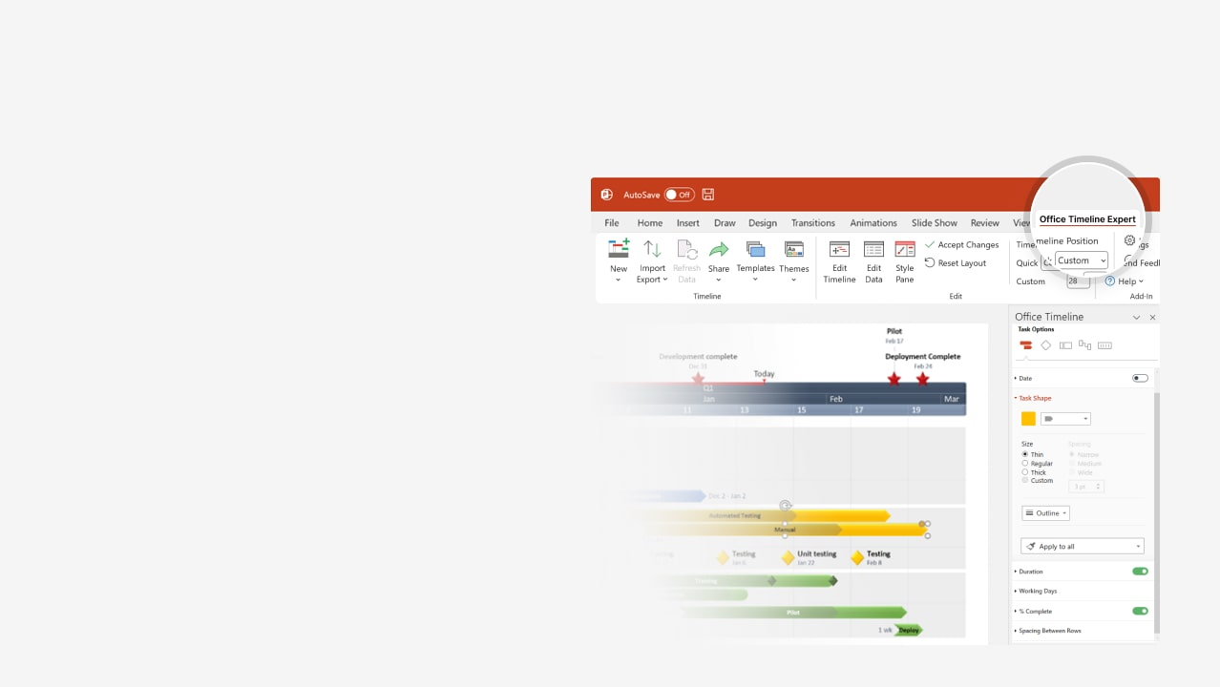

How to update this template in seconds
The Office Timeline add-in for PowerPoint will help you edit it with just a few clicks.
Get your free 14-day trial of Office Timeline here:
https://www.officetimeline.com/office-timeline/14-days-trial
Re-open this template, and create your impressive
PowerPoint visual in 3 easy steps:
1
Click the Edit Data button on the Office Timeline tab.
2
Use the Data and Timeline views to edit swimlanes, milestones and tasks.
3
Click Save to instantly update the template.

Slide 2

Aug 15
Nov 10
Feb 15
2025
2026
Today
Construction Schedule
35 days
Task 1
7/5 - 8/8
45 days
Task 2
7/30 - 9/12
47 days
Task 3
8/20 - 10/5
48 days
Task 4
8/29 - 10/15
40 days
Task 5
10/29 - 12/7
Milestone 2
Milestone 4
Jun
Jul
Aug
Sep
Oct
Nov
Dec
2026
Feb
Jun 18
Milestone 3
Feb 25
Milestone 1
Milestone 5

