Slide 1
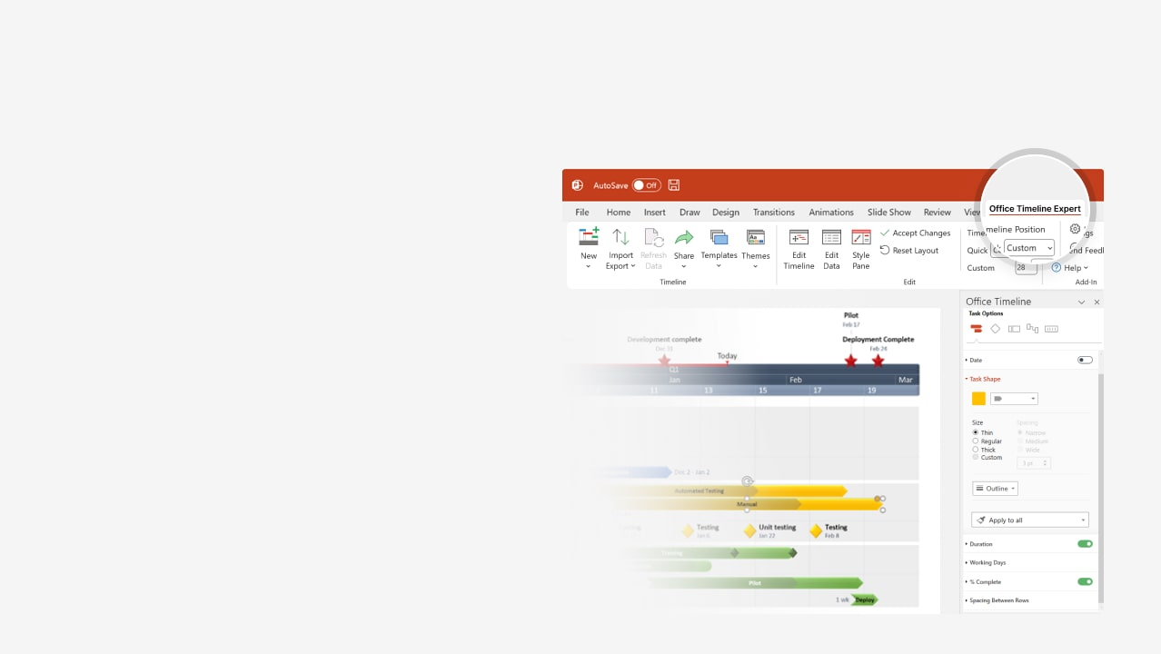

How to update this template in seconds
The Office Timeline add-in for PowerPoint will help you edit it with just a few clicks.
Get your free 14-day trial of Office Timeline here:
https://www.officetimeline.com/office-timeline/14-days-trial
Re-open this template, and create your impressive
PowerPoint visual in 3 easy steps:
1
Click the Edit Data button on the Office Timeline tab.
2
Use the Data and Timeline views to edit swimlanes, milestones and tasks.
3
Click Save to instantly update the template.

Slide 2

12 days
19 days
25 days
15 days
35 days
17 days
23 days
17 days
20 days
12 days
5 days
2025
2025
Project Status Report
Feb 12 - Mar 10
100%
Scope
Feb 15 - Mar 23
76%
Project Resources
Mar 1 - Mar 23
100%
Analysis
Mar 23 - May 10
70%
Design
May 10 - May 16
37%
Draft Specs
Apr 27 - May 20
40%
Development
May 9 - Jun 10
20%
Coding
May 17 - Jun 10
75%
UI
May 24 - Jun 22
15%
Testing
Jun 1 - Jun 17
0%
Training
May 29 - Jun 14
10%
Documentation
Project Sponsor
Analysis Complete
Functional Design Complete
Project Status Report
Feb 15
Mar 23
May 10
Jun 14
Feb
Mar
Apr
May
Jun
Today

