Slide 1
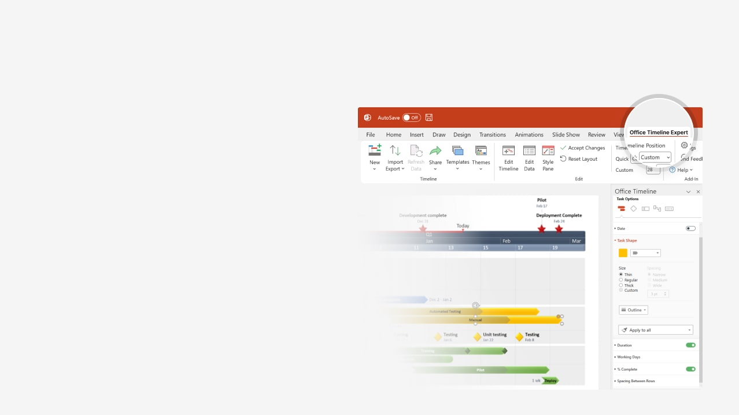

How to update this template in seconds
The Office Timeline add-in for PowerPoint will help you edit it with just a few clicks.
Get your free 14-day trial of Office Timeline here:
https://www.officetimeline.com/office-timeline/14-days-trial
Re-open this template, and create your impressive
PowerPoint visual in 3 easy steps:
1
Click the Edit Data button on the Office Timeline tab.
2
Use the Data and Timeline views to edit swimlanes, milestones and tasks.
3
Click Save to instantly update the template.

Slide 2

Project outline
May 28 - Jun 4
Prepare
May 28 - Jun 1
Develop Charter
Jun 1 - Jun 3
Draft Scope
Jun 1 - Jun 4
Finalize Scope
Jun 5 - Jun 9
Work Breakdown Structure
Jun 8 - Jun 18
Plan Risks
Jun 15 - Jun 18
Manage Quality
Jun 17 - Jun 20
Manage Project Work
Jun 21 - Jun 24
Financial Adherence
Jun 26 - Jun 28
Close Contracts
Jun 25 - Jun 28
Schedule Adherence
Jun 1 - Jun 18
Plan
Jun 14 - Jun 20
Execute
Jun 19 - Jun 28
Monitor
Jun 26 - Jun 30
Close
Project Sign-Off
Jun 30
Week 1
2
3
4
5
6
Jun 4
Jun 12
Jun 24
Present Project Schedule
Budget Due
Stakeholder Review

