Slide 1
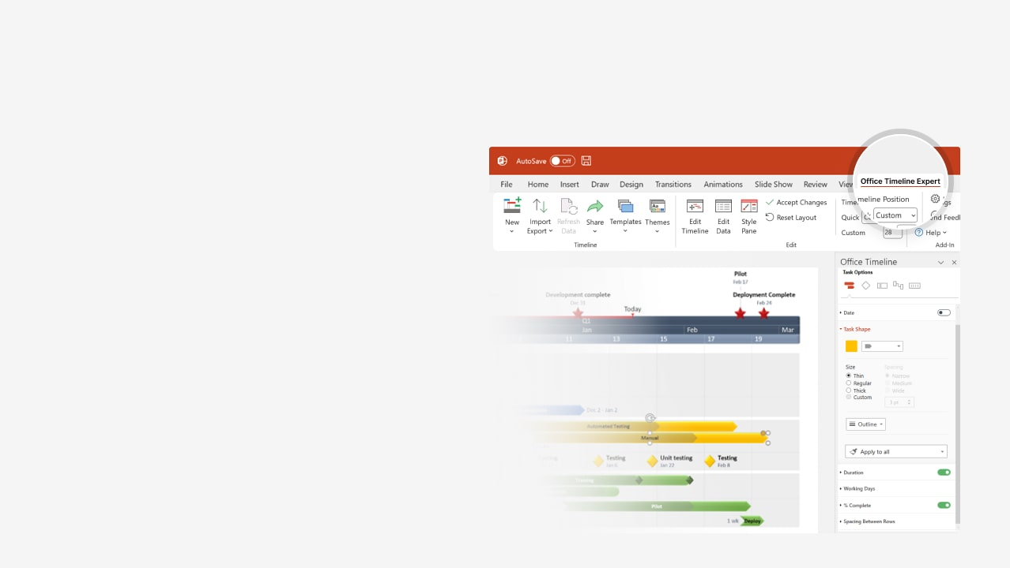

How to update this template in seconds
The Office Timeline add-in for PowerPoint will help you edit it with just a few clicks.
Get your free 14-day trial of Office Timeline here:
https://www.officetimeline.com/office-timeline/14-days-trial
Re-open this template, and create your impressive
PowerPoint visual in 3 easy steps:
1
Click the Edit Data button on the Office Timeline tab.
2
Use the Data and Timeline views to edit swimlanes, milestones and tasks.
3
Click Save to instantly update the template.

Slide 2

2025
2025
Today
Project Template
Units Available
Certification
Production
08/29/25
11/07/25
12/18/25
Q2
Q3
Q4
May
Jun
Jul
Aug
Sep
Oct
Nov
Dec
Day 1
30
59
88
117
146
175
204
Phase 1
Mechanical Design
Planning
05/08/25
Phase 2
Electrical Design
06/03/25
Resources
Material Available
Drawing's Released
07/28/25
08/13/25
Pending Results
Testing
Testing Completed
10/13/25
Performance Results
09/23/25
10/26/25
Production
Build Start
Conditional Release
08/25/25
09/03/25

