Slide 1
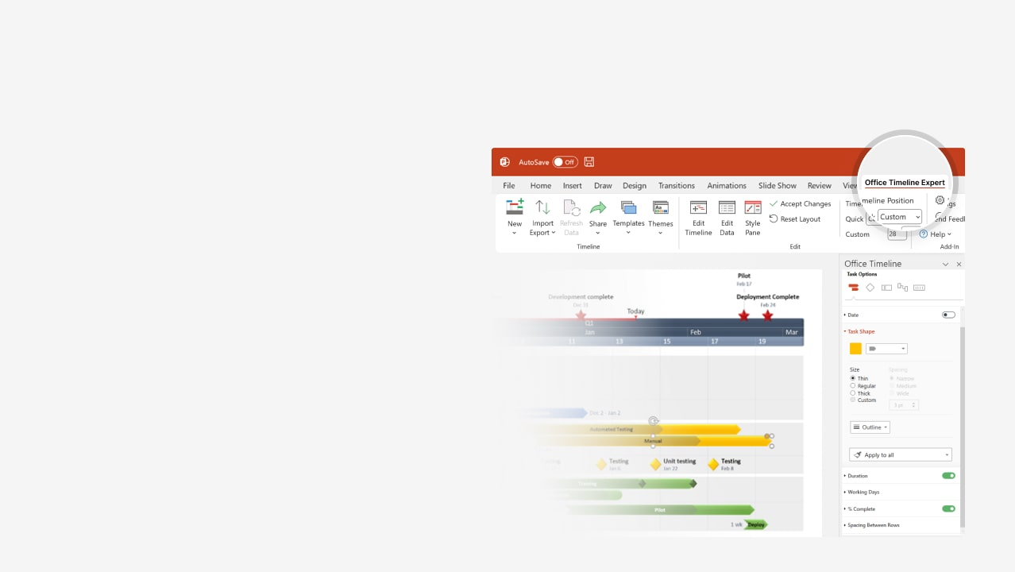

How to update this template in seconds
The Office Timeline add-in for PowerPoint will help you edit it with just a few clicks.
Get your free 14-day trial of Office Timeline here:
https://www.officetimeline.com/office-timeline/14-days-trial
Re-open this template, and create your impressive
PowerPoint visual in 3 easy steps:
1
Click the Edit Data button on the Office Timeline tab.
2
Use the Data and Timeline views to edit swimlanes, milestones and tasks.
3
Click Save to instantly update the template.

Slide 2

Project Management Plan
0.2 months
Requirements Gathering
1 month
Business Requirements Alignment
0.4 months
Analysis
1.5 months
Alignment with Other Departments
0.8 months
Design Comparisons
3 months
Vendor Selection
19.2 months
Maintenance
1 month
Effort Estimation
13 months
PM Preparation
1.4 months
Prototyping
8 months
Implementation
1 month
API Dev
6 months
Customization
1.2 months
User Interface
1.1 months
Usability
0.5 months
Testing Matrix
4 months
Testing 1
1.5 months
Testing 2
2.2 months
Documentation
2.1 months
Production
Project Start
5/1/2024
Implementation Finished
Testing Finished
Phase 1 Kickoff
Project Approved
Phase 1 Close
4/10/2024
7/31/2024
6/16/2025
10/15/2025
1/1/2026
2024
Apr
Jun
Aug
Oct
Dec
Feb
Apr
Jun
Aug
Oct
Dec
2026
Today

