Slide 1
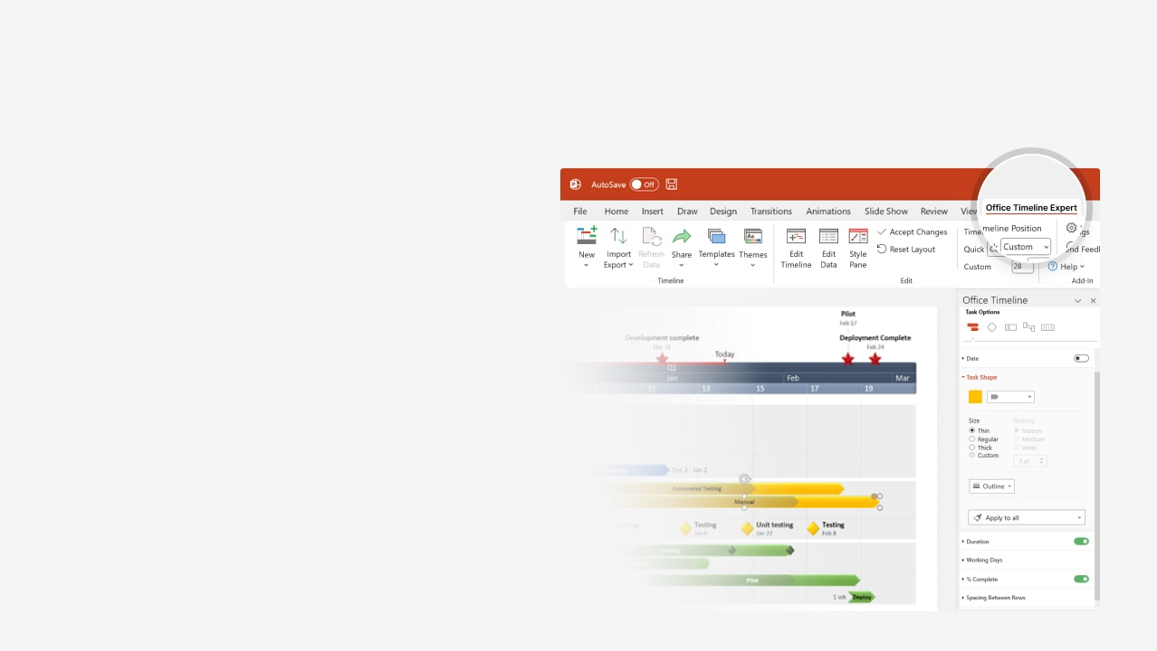

How to update this template in seconds
The Office Timeline add-in for PowerPoint will help you edit it with just a few clicks.
Get your free 14-day trial of Office Timeline here:
https://www.officetimeline.com/office-timeline/14-days-trial
Re-open this template, and create your impressive
PowerPoint visual in 3 easy steps:
1
Click the Edit Data button on the Office Timeline tab.
2
Use the Data and Timeline views to edit swimlanes, milestones and tasks.
3
Click Save to instantly update the template.

Slide 2

143 days
201 days
108 days
100 days
145 days
149 days
297 days
93 days
2024
2028
Meeting
Presentation
Checkpoint
Main Event
5-Year Plan
Template
Today
May 1
May 1
Jan 1
Oct 30
2024
2025
2026
2027
2028
Q1
Q3
Q1
Q3
Q1
Q3
Q1
Q3
Q1
Q3
Jan
Jun
Nov
Apr
Sep
Feb
Jul
Dec
May
Oct
Mar
Aug
Oct 15
Jan 10
Nov 1
Jul 1
Beta. 1.34
Version 2
Testing 2.1
Marketing Process
Jan 15 - Jul 31
Description of features used/or planning to be used
Planning
Jan 17 - Oct 23
Description of data collection process
Jan 31 - Jun 28
Algorithm description
Execution
Design
Mar 8 - Jul 16
Complete design
Implementation
Apr 7 - Aug 24
Complete implementation
Apr 7 - Oct 26
Indicate the parts of the project that have been completed
Reporting
Apr 7 - Oct 31
Indicate the parts which have not been completed and how you plan to accomplish them for the final project report
Nov 7 - Dec 27
Final report due

