Slide 1
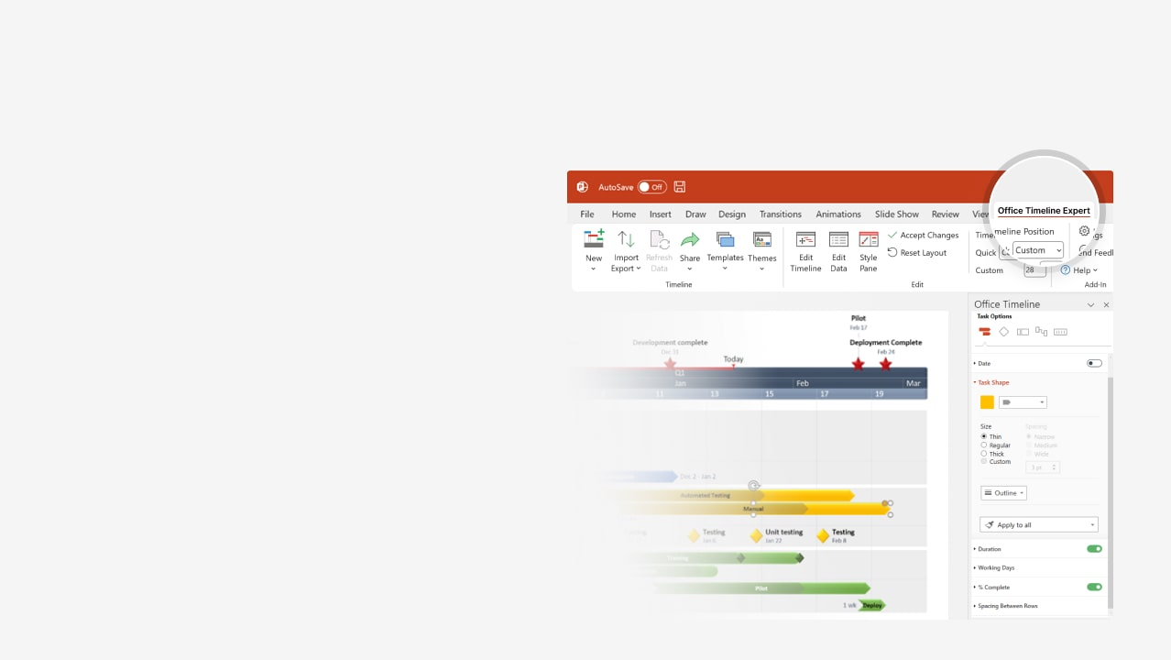

How to update this template in seconds
The Office Timeline add-in for PowerPoint will help you edit it with just a few clicks.
Get your free 14-day trial of Office Timeline here:
https://www.officetimeline.com/office-timeline/14-days-trial
Re-open this template, and create your impressive
PowerPoint visual in 3 easy steps:
1
Click the Edit Data button on the Office Timeline tab.
2
Use the Data and Timeline views to edit swimlanes, milestones and tasks.
3
Click Save to instantly update the template.

Slide 2

2024
2024
Basic Gantt Chart
77 days
Recruit
1/15 - 4/30
30 days
Legal Agreements
3/30 - 5/12
55 days
Architecture Review
4/15 - 6/30
55 days
Training Calls
4/15 - 6/30
90 days
Partner Development
6/29 - 11/3
34 days
Marketing
10/15 - 11/30
Today
Jan
Feb
Mar
Apr
May
Jun
Jul
Aug
Sep
Oct
Nov
01.15.2024
06.30
08.15
10.11
11.30.2024
Project Start
Validation Call 1
Validation Call 2
Validation Call 3
Project End

