Slide 1
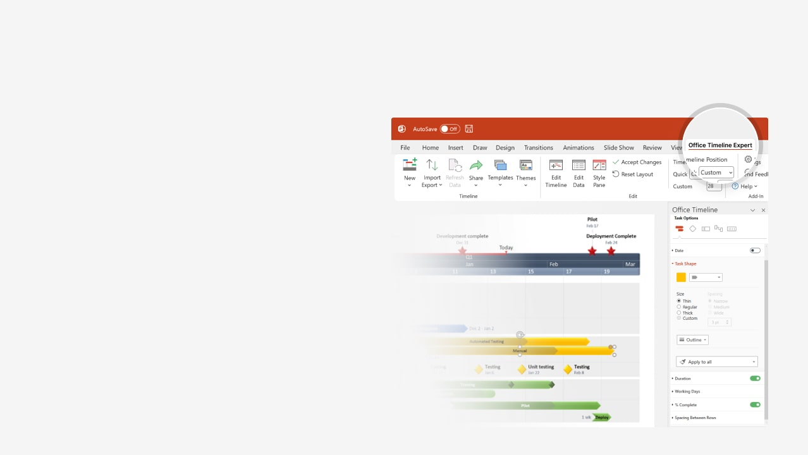

How to update this template in seconds
The Office Timeline add-in for PowerPoint will help you edit it with just a few clicks.
Get your free 14-day trial of Office Timeline here: https://www.officetimeline.com/office-timeline/14-days-trial Re-open this template, and create your impressive PowerPoint visual in 3 easy steps:
1
Click the Edit Data button on the Office Timeline tab.
2
Use the Data and Timeline views to edit swimlanes, milestones and tasks.
3
Click Save to instantly update the template.

Slide 2

Project management process
2024
2025
2024
May
Jul
Sep
Nov
Jan
Mar
May
Jul
Sep
Nov
2025
Today
10/15/2025
4/16/2025
Milestone 5
7/24/2024
Milestone 3
Milestone 1
11/21/2024
8/15/2025
Milestone 2
Milestone 4
Sep 30 - Dec 31
13.4 wks
Task 8
May 30 - Sep 30
17.6 wks
Task 7
Jan 1 - Jun 30
25.8 wks
Task 6
Oct 1 - May 30
34.8 wks
Task 5
Aug 1 - Dec 29
21.4 wks
Task 4
Jun 1 - Sep 1
13 wks
Task 3
Jun 1 - Aug 6
9.4 wks
Task 2
May 1 - Jun 22
7.6 wks
Task 1

