Slide 1
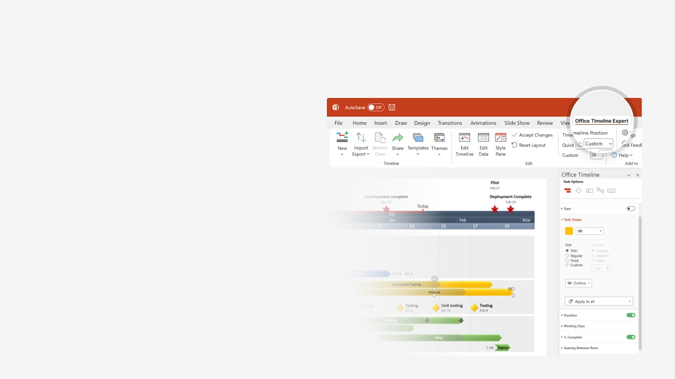

How to update this template in seconds
The Office Timeline add-in for PowerPoint will help you edit it with just a few clicks.
Get your free 14-day trial of Office Timeline here:
https://www.officetimeline.com/office-timeline/14-days-trial
Re-open this template, and create your impressive
PowerPoint visual in 3 easy steps:
1
Click the Edit Data button on the Office Timeline tab.
2
Use the Data and Timeline views to edit swimlanes, milestones and tasks.
3
Click Save to instantly update the template.

Slide 2

Content Calendar
January Calendar
February Calendar
March Calendar
Jan 3 - Jan 20
Feb 7 - Feb 16
Mar 7 - Mar 24
Post: Planning with Templates
Infographic
SEO article: Content Planning
Jan 17 - Feb 2
Feb 23 - Mar 14
Guest post: Status Reporting
Blog Category: Gantt Charts 101
Jan 2 - Jan 23
Feb 2 - Feb 18
Mar 14 - Mar 29
Branch: Visual Planning for Marketers
Template: Content Calendar
Branch: Task Management
Jan 18 - Jan 27
Feb 14 - Feb 24
Feb 28 - Mar 11
Product Page
Testimonial Page
Case Study Page
Jan 7 - Jan 20
Feb 3 - Feb 19
Mar 14 - Mar 28
Quick Start Video
KB Article: Assigning users
Webinar for Beginners
Week 1
3
5
7
9
11
13
Jan 18
Feb 3
Feb 20
Mar 31
Publish Video
Publish Guest Post
Publish KB Article
Approve Q2 Calendar
Jan 1
Mar 12
Review Q1 Calendar
Publish Case Study

