Slide 1
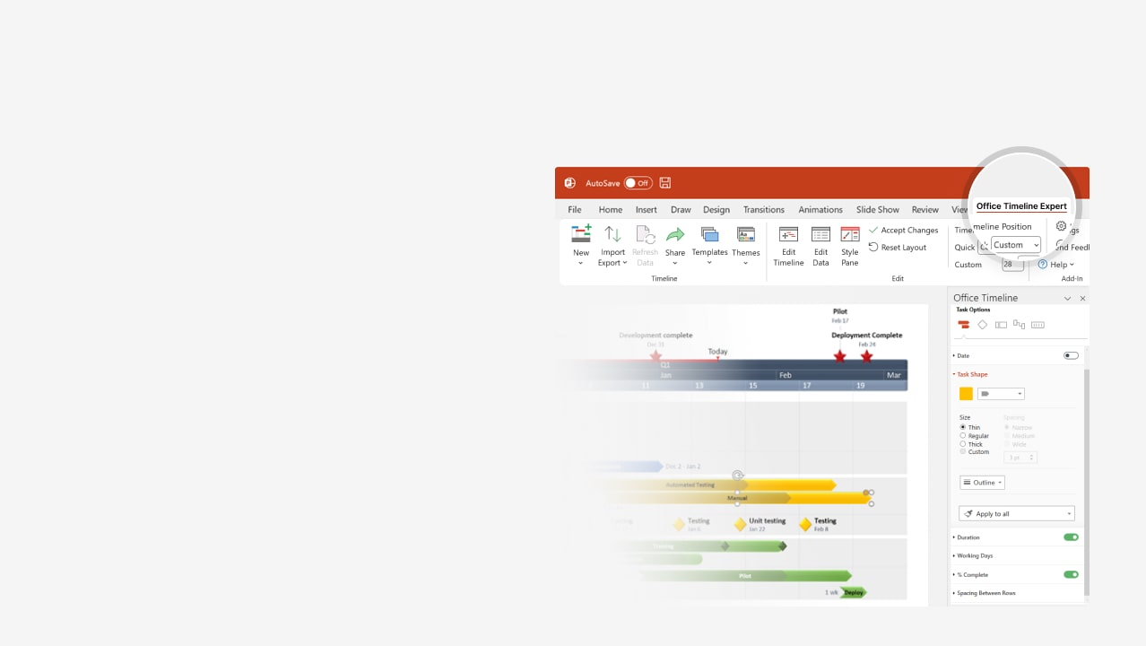

How to update this template in seconds
The Office Timeline add-in for PowerPoint will help you edit it with just a few clicks.
Get your free 14-day trial of Office Timeline here:
https://www.officetimeline.com/office-timeline/14-days-trial
Re-open this template, and create your impressive
PowerPoint visual in 3 easy steps:
1
Click the Edit Data button on the Office Timeline tab.
2
Use the Data and Timeline views to edit swimlanes, milestones and tasks.
3
Click Save to instantly update the template.

Slide 2

195.5 days
100.5 days
33.5 days
87.5 days
64.5 days
73.5 days
99.5 days
94.5 days
73.5 days
32.5 days
74.5 days
61.5 days
55.5 days
75.5 days
73.5 days
75.5 days
108 days
69 days
80 days
98 days
70 days
2024
85%
80%
25%
85%
75%
70%
85%
75%
75%
80%
65%
2025
Today
Technology Roadmap with Swimlanes Template
Q3
Q4
Q1
2025
Q2
Q3
Phase 1
Dec 27
Phase 2
Phase 3
Mar 27
Jul 5
System Balancing
Delivery
Consumption Metrics
Offloading
Iframes
Perf Check
Dec 5
Jun 18
SDK Optimization
Load Performance
Security Policy
Conf Stations
Documentation
Sourcecode
Equip Docs
Ops
Dec 2
Onramp
May 21
Recruit: Round 1
Recruit: Round 2
Logs
Certification
Risk Mgt
Access Control
Content Management
Risk Training
User Passwords
SLA Metrics
QoS
Availability Metrics
Onboarding
Alerting

