Slide 1
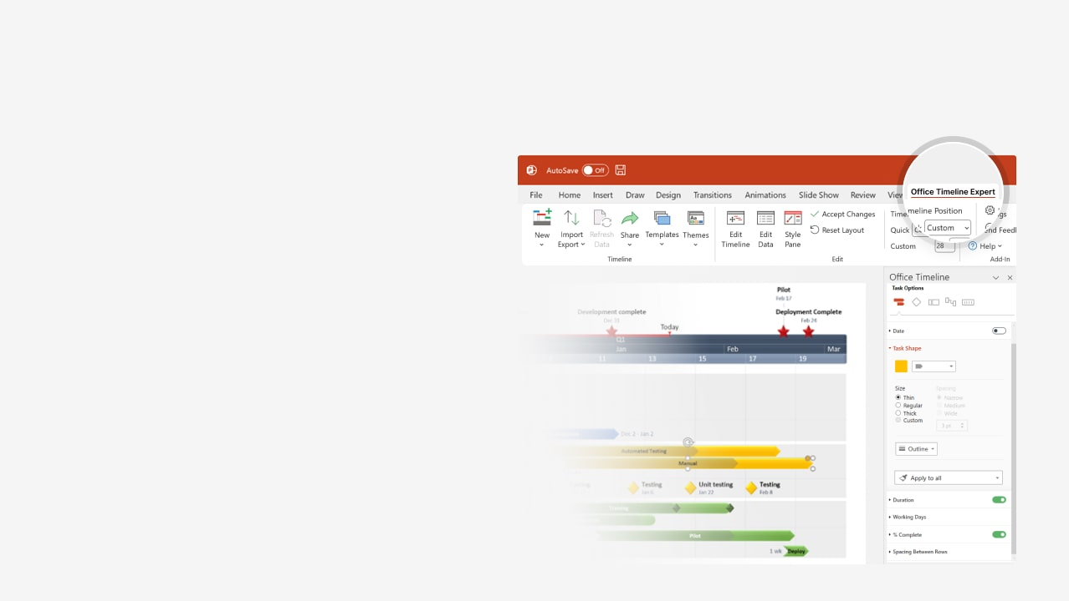

How to update this template in seconds
The Office Timeline add-in for PowerPoint will help you edit it with just a few clicks.
Get your free 14-day trial of Office Timeline here:
https://www.officetimeline.com/office-timeline/14-days-trial
Re-open this template, and create your impressive
PowerPoint visual in 3 easy steps:
1
Click the Edit Data button on the Office Timeline tab.
2
Use the Data and Timeline views to edit swimlanes, milestones and tasks.
3
Click Save to instantly update the template.

Slide 2
0 days
0 days
0 days
0 days
2025
Today
2029
Clinical Trial Gantt chart
Apply for Drug Approval
Estimated Drug Approval Date
Report
Report
Oct 15 '25
Aug 10 '27
May 18 '28
Nov 11 '28
2025
2026
2027
2028
2029
Jan
Mar
May
Jul
Sep
Nov
Jan
Mar
May
Jul
Sep
Nov
Jan
Mar
May
Jul
Sep
Nov
Jan
Mar
May
Jul
Sep
Nov
Jan
Stages
Recruitment
Enrollment
Kick-off
Modifications
Patients
Recruited
0 days
Patients
Enrolled
0 days
Study
Kick-off
0 days
Phase I
Feb 4 '25
Jun 3 '25
Sep 9 '25
+30.7 days
Trial
18 mons
Jan 2025 - Jun 2026
Patients
Recruited
Patients
Enrolled
Study
Kick-off
Study
Modified
Phase II
Aug 7 '26
0 days
Dec 11 '26
0 days
May 8 '27
0 days
Sep 17 '27
0 days
+32 days
Trial
19 mons
Jul 2026 - Jan 2028
Patients
Recruited
Patients
Enrolled
Study
Kick-off
0 days
Oct 11 '27
Feb 10 '28
May 15 '28
Phase III
0 days
0 days
0 days
Made with
Trial
14 mons
Sep 2027 - Nov 2028

