Slide 1
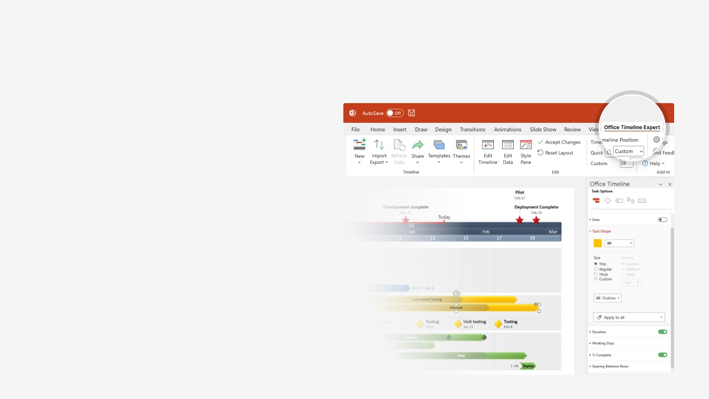

How to update this template in seconds
The Office Timeline add-in for PowerPoint will help you edit it with just a few clicks.
Get your free 14-day trial of Office Timeline here:
https://www.officetimeline.com/office-timeline/14-days-trial
Re-open this template, and create your impressive
PowerPoint visual in 3 easy steps:
1
Click the Edit Data button on the Office Timeline tab.
2
Use the Data and Timeline views to edit swimlanes, milestones and tasks.
3
Click Save to instantly update the template.

Slide 2

Project management timeline
Phase 2 Here
Jun 1
9.6 weeks
Aug 6
Phase 3 Here
Jun 1
13.2 weeks
Sep 1
Phase 5 Here
Oct 1
34.6 weeks
May 30
Phase 7 Here
Jan 1
25.8 weeks
Jun 30
Phase 9 Here
Sep 1
6.6 weeks
Oct 15
Phase 10 Here
Sep 30
13.4 weeks
Dec 31
Target 1
Target 2
Target 3
May 30
Oct 1
Jan 1
Week 1
9
17
25
33
41
49
57
65
73
81
Jul 1
Oct 15
Target 4
Target 5
Phase 1 Here
May 1
7.4 weeks
Jun 22
Phase 4 Here
Aug 1
21.4 weeks
Dec 29
Phase 6 Here
Oct 1
34.6 weeks
May 30
Phase 8 Here
May 30
17.6 weeks
Sep 30

