Slide 1
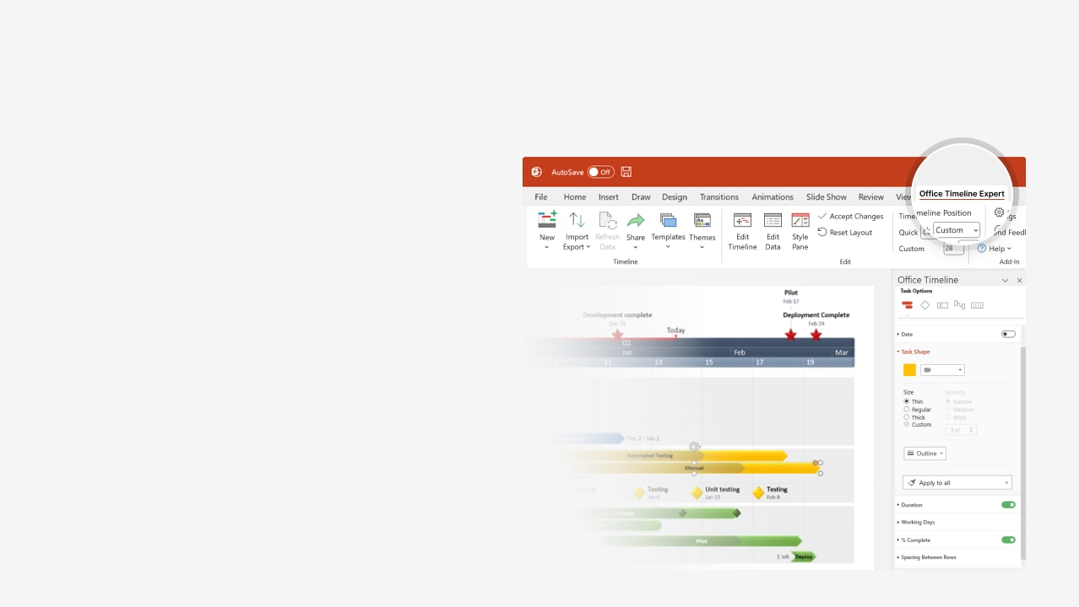

How to update this template in seconds
The Office Timeline add-in for PowerPoint will help you edit it with just a few clicks.
Get your free 14-day trial of Office Timeline here:
https://www.officetimeline.com/office-timeline/14-days-trial
Re-open this template, and create your impressive
PowerPoint visual in 3 easy steps:
1
Click the Edit Data button on the Office Timeline tab.
2
Use the Data and Timeline views to edit swimlanes, milestones and tasks.
3
Click Save to instantly update the template.

Slide 2
Jan 20 - Dec 9
Mar 1 - Jan 15
Apr 1 - Dec 2
Apr 1 - Mar 1
-22 days
232 days
176 days
239 days
230 days
0 days
0 days
0 days
0 days
0 days
0 days
0 days
0 days
0 days
0 days
0 days
0 days
0 days
0 days
0 days
0 days
0 days
0 days
0 days
0 days
0 days
0 days
0 days
Today
2026
2027
International Pharma product launch timeline
2026
2027
Jan
Feb
Mar
Apr
May
Jun
Jul
Aug
Sep
Oct
Nov
Dec
Jan
Feb
Mar
United States
China
Japan
Germany
United Kingdom
India
Product
Alpha
Jan 20
Apr 28
Jul 4
Aug 15
Sep 28
Dec 8
Timeline
United States
China
Japan
Germany
India
United Kingdom
Product
Beta
Mar 1
May 14
Jul 1
Aug 12
Dec 5
Jan 15
Timeline
United States
China
Japan
Germany
United Kingdom
India
Product
Gamma
Apr 1
May 18
Jul 5
Sep 4
Oct 13
Nov 30
Timeline
United States
China
Japan
Germany
United Kingdom
India
Made with
Product
Delta
Apr 1
Jun 22
Aug 17
Nov 3
Dec 30
Mar 1
Timeline

