Slide 1
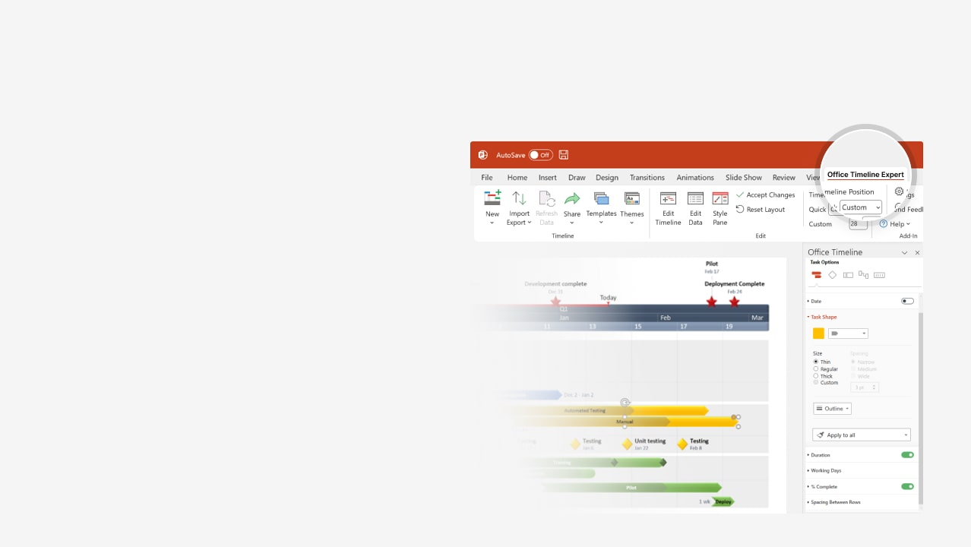

How to update this template in seconds
The Office Timeline add-in for PowerPoint will help you edit it with just a few clicks.
Get your free 14-day trial of Office Timeline here: https://www.officetimeline.com/office-timeline/14-days-trial Re-open this template, and create your impressive PowerPoint visual in 3 easy steps:
1
Click the Edit Data button on the Office Timeline tab.
2
Use the Data and Timeline views to edit swimlanes, milestones and tasks.
3
Click Save to instantly update the template.

Slide 2

+261 days
+261 days
+260 days
14 days
14 days
11 days
9 days
7 days
9 days
8 days
5 days
4 days
2 days
8 days
100%
2026
Week 1
Renovation timeline
Demolition completed
First inspection
Final walkthrough and approval
Today
Aug 26
Dec 22
Jan 16
2026
2027
Aug
Sep
Oct
Nov
Dec
Jan
2027
2
3
4
5
6
7
8
9
10
11
12
13
14
15
16
17
18
19
20
21
22
23
24
Site survey and inspection
Site preparation
Aug 3 - Aug 4
100%
Site clearance
Aug 5 - Aug 13
Demolition
60%
Demolition
Aug 14 - Aug 26
Framing & structural work
Sep 4 - Sep 15
0%
Frame building structure
Sep 23 - Oct 12
0%
Install structural components
Electrical & plumbing
Oct 20 - Oct 31
0%
Rough-in electrical wiring
Oct 22 - Nov 10
0%
Rough-in plumbing
Nov 15 - Nov 25
0%
Install fixtures & connections
Dec 1 - Dec 15
0%
Install drywall & insulation
Dec 16 - Dec 22
0%
Paint interior walls & ceilings
Interior finishing
Jan 7 - Jan 12
0%
Flooring installation

