Slide 1
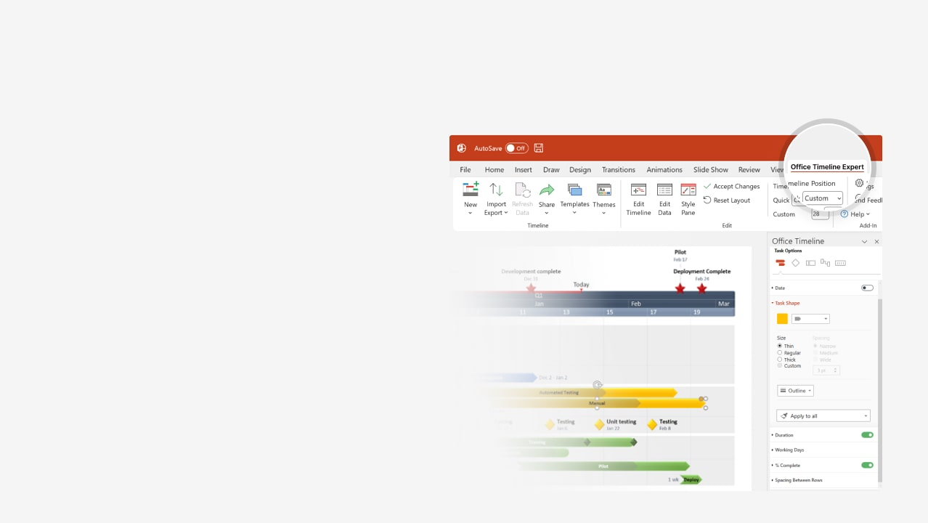

How to update this template in seconds
The Office Timeline add-in for PowerPoint will help you edit it with just a few clicks.
Get your free 14-day trial of Office Timeline here: https://www.officetimeline.com/office-timeline/14-days-trial Re-open this template, and create your impressive PowerPoint visual in 3 easy steps:
1
Click the Edit Data button on the Office Timeline tab.
2
Use the Data and Timeline views to edit swimlanes, milestones and tasks.
3
Click Save to instantly update the template.

Slide 2

0 days
0 days
0 days
0 days
0 days
0 days
0 days
0 days
0 days
0 days
Aug 18
Aug 24
12 days
12 days
11 days
11 days
12 days
11 days
11 days
7 days
2 days
3 days
8 days
7 days
8 days
Mar 14
Jul 15
8 days
Jun 1
0%
0%
0%
0%
0%
0%
0%
0%
0%
0%
0%
0%
0%
0%
2026
Week 1
Construction building
Today
Mar
Apr
May
Jun
Jul
Aug
2026
2
3
4
5
6
7
8
9
10
11
12
13
14
15
16
17
18
19
20
21
22
23
24
25
26
Site survey and land inspection
Site clearing & excavation
Surveying & site prep
Mar 1 - Mar 3
+2 days
Site clearing and excavation
Mar 4 - Mar 14
Concrete foundation
Foundation curing
Foundation pour
0 days
Pour foundation concrete
Mar 11 - Mar 14
Structural framing
Mar 11 - Mar 26
Install steel framing
Steel framing
Mar 26 - Apr 10
Frame building structure
Mechanical & electrical systems
Electrical systems
Apr 1 - Apr 15
Install electrical wiring
Apr 5 - Apr 15
+3 days
Install plumbing systems
HVAC systems
Apr 10 - Apr 20
0 days
Install HVAC systems
Roofing
May 1 - May 15
-2 days
Install roof structure
Roofing & glazing
Final inspection of roofing & glazing
Glazing
May 15 - Jun 1
0 days
Install windows and glazing
Drywall & insulation
Jun 1 - Jun 15
Install drywall and insulation
Interior construction
Jun 10 - Jun 20
0 days
Paint interior walls and ceilings
Flooring
Jun 18 - Jun 27
-1 day
Install flooring
Exterior finishing
Exterior painting
Final exterior inspection
Jul 1 - Jul 15
Exterior painting and finishing
0 days
Final inspection
Approval
First inspection
Sign-off

