Slide 1
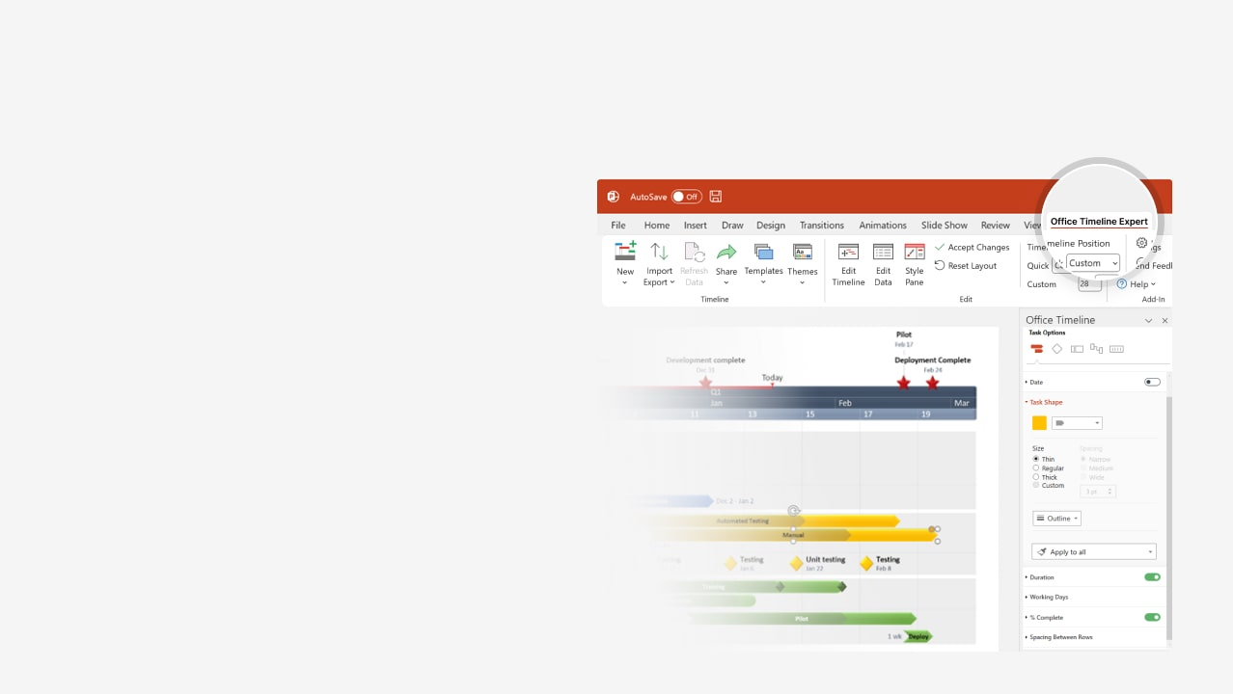

How to update this template in seconds
The Office Timeline add-in for PowerPoint will help you edit it with just a few clicks.
Get your free 14-day trial of Office Timeline here: https://www.officetimeline.com/office-timeline/14-days-trial Re-open this template, and create your impressive PowerPoint visual in 3 easy steps:
1
Click the Edit Data button on the Office Timeline tab.
2
Use the Data and Timeline views to edit swimlanes, milestones and tasks.
3
Click Save to instantly update the template.

Slide 2

Project Budget
Day 1
34
67
100
133
166
199
232
265
298
331
364
Strategy Budget: $13,000
90%
20%
73%
Strategy: $4,500
Methodology: $2,500
Validation: $6,000
Execution Budget: $35,500
70%
50%
15%
80%
Documentation: $11,000
Apps: $16,500
Testing: $6,000
Training: $2,000
Monitoring Budget: $7,500
45%
20%
60%
92%
Sustainment: $1,500
Scheduling: $1,000
Baselining: $1,500
Reporting: $3,500

