Slide 1
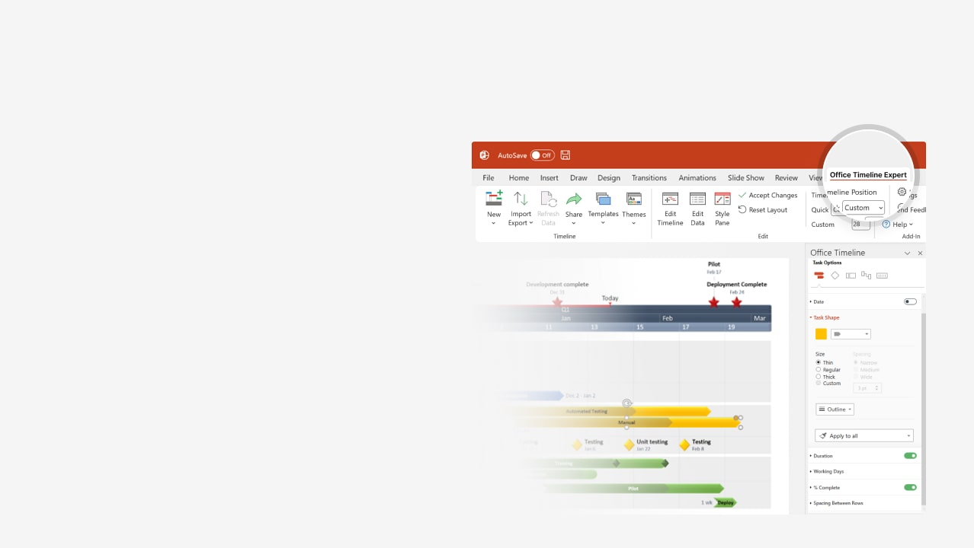

How to update this template in seconds
The Office Timeline add-in for PowerPoint will help you edit it with just a few clicks.
Get your free 14-day trial of Office Timeline here: https://www.officetimeline.com/office-timeline/14-days-trial Re-open this template, and create your impressive PowerPoint visual in 3 easy steps:
1
Click the Edit Data button on the Office Timeline tab.
2
Use the Data and Timeline views to edit swimlanes, milestones and tasks.
3
Click Save to instantly update the template.

Slide 2

+3 days
0 days
0 days
0 days
0 days
10 days
15 days
10 days
2 days
7 days
5 days
4 days
8 days
7 days
9 days
5 days
5 days
0%
0%
0%
0%
0%
0%
0%
0%
0%
0%
0%
0%
2026
Today
Week 1
Infrastructure roadmap
Site handover to contractor
Final handover to client
Mar 1
Jul 9
Mar
Apr
May
Jun
Jul
2026
2
3
4
5
6
7
8
9
10
11
12
13
14
15
16
17
18
19
Survey land and site inspection
Land surveying
Surveying
Mar 1 - Mar 3
Finalize land survey
Mar 4
Excavation & groundworks
Excavation
Mar 6 - Mar 16
Begin excavation and site preparation
Groundworks
Mar 17 - Mar 23
Complete groundwork and trenching
Piling & foundations
Foundation piling
Install piling and foundations
Mar 21 - Apr 5
Foundation curing and inspections
Apr 6
Preparation
Apr 10 - Apr 15
Pour concrete foundation
Concrete works
Pouring
Apr 16 - Apr 27
Pour slabs and supports
Curing & inspection
Apr 25 - May 5
Concrete curing and structural inspection
Road work & paving
Excavation
May 6 - May 18
Begin excavation for road base
Road paving
May 15 - Jun 4
Lay asphalt and road surfacing
Excavation
Jun 4 - Jun 10
Dig trenches for utility lines
Utilities installation
Install water, gas, and electric lines
Installation
Inspect utility installations
Jun 10 - Jun 23
Jun 24
Inspection & handover
Final inspections
Jun 29 - Jul 5
Final site inspections

