Slide 1
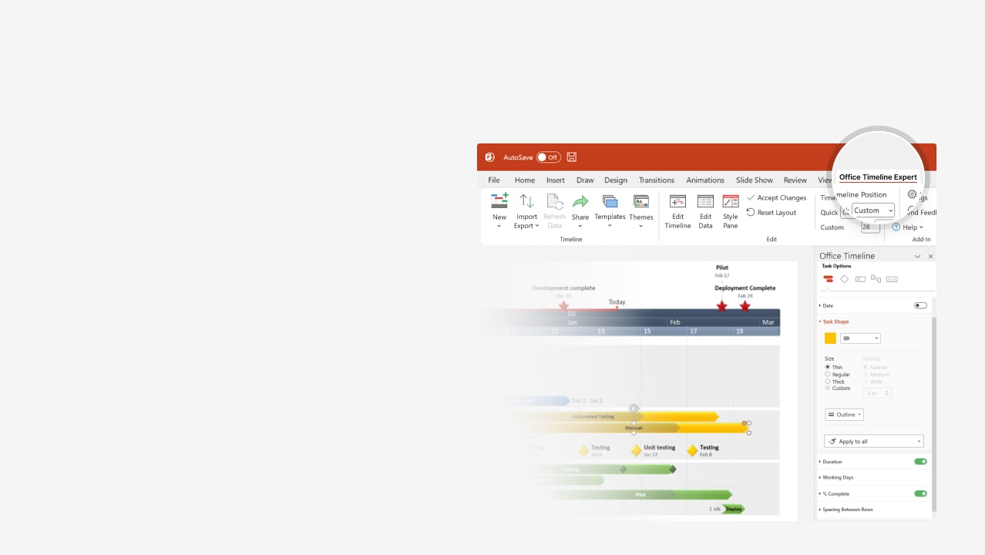

How to update this template in seconds
The Office Timeline add-in for PowerPoint will help you edit it with just a few clicks.
Get your free 14-day trial of Office Timeline here:
https://www.officetimeline.com/office-timeline/14-days-trial
Re-open this template, and create your impressive
PowerPoint visual in 3 easy steps:
1
Click the Edit Data button on the Office Timeline tab.
2
Use the Data and Timeline views to edit swimlanes, milestones and tasks.
3
Click Save to instantly update the template.

Slide 2

+261 days
10/26 - 11/26
11/26 - 11/26
11/26 - 12/26
12/26 - 12/26
9/26 - 10/26
9/26 - 10/26
12/26 - 1/27
+261 days
+261 days
+261 days
+261 days
+261 days
+261 days
+261 days
4/26 - 4/26
5/26 - 6/26
5/26 - 5/26
4/26 - 5/26
6/26 - 7/26
7/26 - 9/26
50 days
10 days
20 days
85 days
15 days
15 days
10 days
75 days
14 days
19 days
49 days
14 days
64 days
19 days
19 days
5 days
Jun 12
Apr 30
Sep 15
Feb 15
Mar 15
6 days
Apr 8
May 7
2026
2027
Apr
Week 1
Online Banking Platform Implementation
Today
2026
2027
Apr
May
Jun
Jul
Aug
Sep
Oct
Nov
Dec
Jan
Feb
Mar
3
5
7
9
11
13
15
17
19
21
23
25
27
29
31
33
35
37
39
41
43
45
47
49
51
Project initiation and planning
4/26 - 6/26
PHASE 1 -
Project
initiation and planning
PMO, Senior management, BA, all relevant
Estimate ROI
Initial budget
Risk assessment
Communication plan
Project scope
Feasibility study
Requirements gathering
Project plan development
System design and development
6/26 - 10/26
System architecture design
PHASE 2 -
System design and development
IT, External security consultants
Development (dev & testing)
Integration testing
Security and penetration testing
Security audit
12/26
Go-live
Testing and deployment
10/26 - 1/27
PHASE 3 -
Testing and deployment
IT, QA, Marketing
User acceptance testing (UAT)
Performance testing
Deployment and go-live
User training
Post-implementation review
PHASE 4 -
Maintenance
12/26 - 3/27
Maintenance and support
IT support
System optimization
Knowledge transfer

