Slide 1
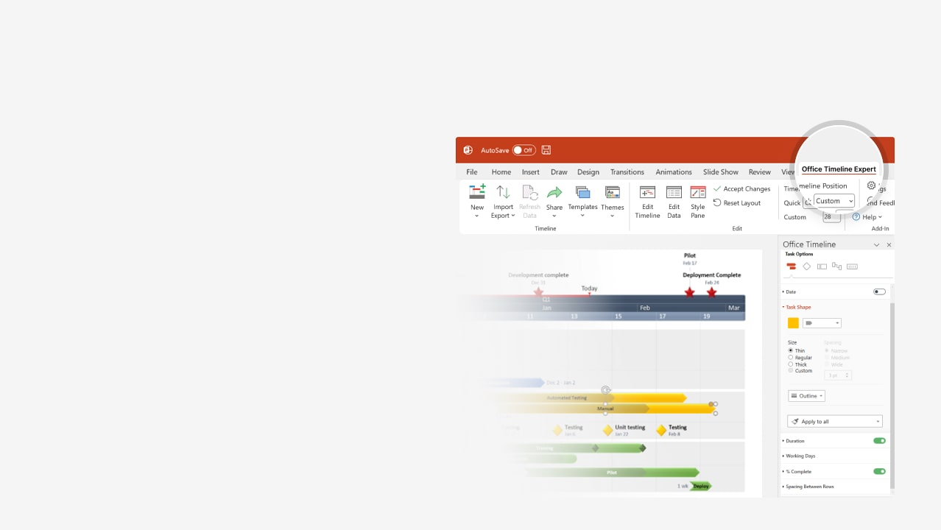

How to update this template in seconds
The Office Timeline add-in for PowerPoint will help you edit it with just a few clicks.
Get your free 14-day trial of Office Timeline here:
https://www.officetimeline.com/office-timeline/14-days-trial
Re-open this template, and create your impressive
PowerPoint visual in 3 easy steps:
1
Click the Edit Data button on the Office Timeline tab.
2
Use the Data and Timeline views to edit swimlanes, milestones and tasks.
3
Click Save to instantly update the template.

Slide 2

Project overview timeline
3 days
Create project charter
7 days
Process definition
5 days
Define deliverables
7 days
Monitoring Phase
10 days
Validate data collection
6 days
Analysis
3 days
Program capability
5 days
Performance levels
7 days
Review work breakdown
5 days
Adjustments Phase
4 days
Triage causes
3 days
Monitoring
Metrics 1
Metrics 2
Operating snapshot
Metrics 3
Jun 12
Jun 20
Jun 26
Jul 2
Day 1
6
11
16
21
26
31
May 29
Jun 7
Jun 16
Jun 22
Jun 28
Identify client issues
Performance thresholds
Statistical review
Adjustments Complete
Implementation

