Slide 1
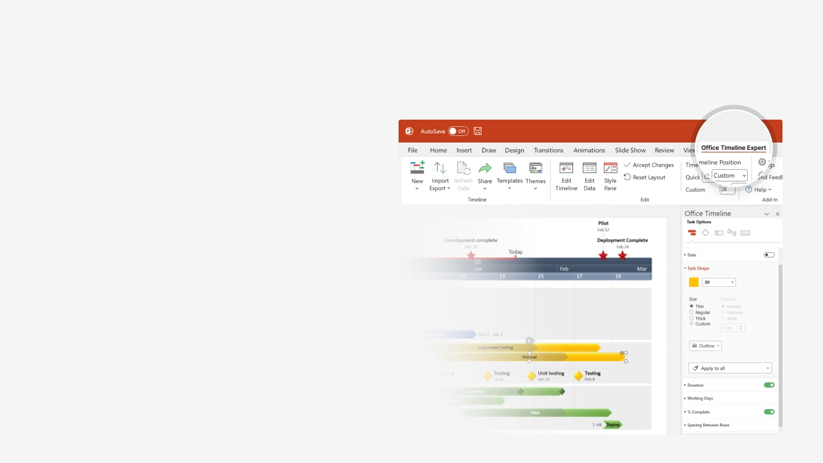

How to update this template in seconds
The Office Timeline add-in for PowerPoint will help you edit it with just a few clicks.
Get your free 14-day trial of Office Timeline here:
https://www.officetimeline.com/office-timeline/14-days-trial
Re-open this template, and create your impressive
PowerPoint visual in 3 easy steps:
1
Click the Edit Data button on the Office Timeline tab.
2
Use the Data and Timeline views to edit swimlanes, milestones and tasks.
3
Click Save to instantly update the template.

Slide 2

12 days
22 days
57 days
29 days
15 days
14 days
30 days
41 days
48 days
29 days
15 days
42 days
57 days
8 days
8 days
8 days
8 days
2026
2027
Feb
Week 1
Private Equity Transaction
Today
Mar
Apr
May
Jun
Jul
Aug
Sep
Oct
Nov
Dec
Jan
Feb
Mar
Apr
May
Jun
Jul
3
5
7
9
11
13
15
17
19
21
23
25
27
29
31
33
35
37
39
41
43
45
47
49
51
53
55
57
59
61
63
65
67
69
71
73
Feb 24 - Mar 14
Teaser sent by bankers
Mar 15 - Mar 25
Marketing
NDA signed
Mar 26 - Apr 24
CIM sent by bankers
Apr 25 - May 6
Calls with management team
Jun 6 - Jul 18
Expression of interest / non-binding offer
Jul 17 - Sep 12
Financial model and valuation
Sep 16 - Sep 25
Data room access granted
Valuation & due diligence
Sep 26 - Oct 7
In-person meeting with management
Oct 8 - Oct 23
Letter of intent
Oct 29 - Jan 4
Exclusivity period and final due diligence
Dec 20 - Jan 28
Quality of earnings report
Dec 21 - Jan 8
Final bid/offer submitted
Jan 9 - Mar 30
Definitive agreements: SPA / APA
Feb 18 - Mar 30
Shareholders’ agreement and other agreements
Negotiations & closing
Feb 11 - Apr 10
Financing secured
Regulatory approvals
Apr 11 - Jun 29
Closing
Jun 30 - Jul 20

