Slide 1
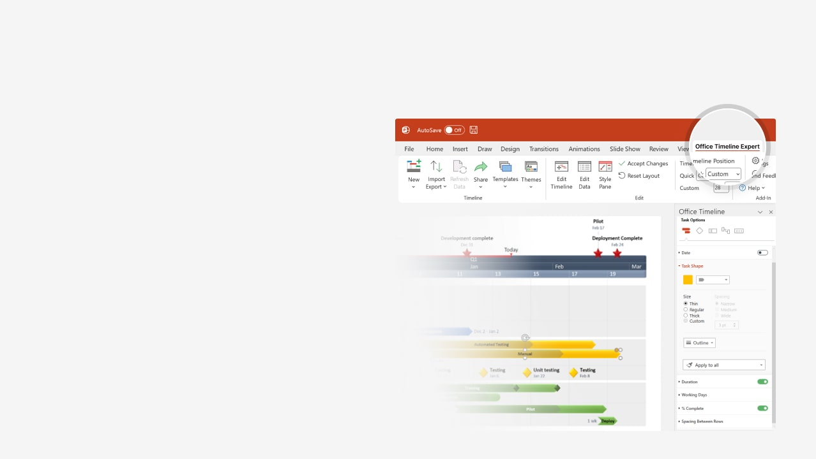

How to update this template in seconds
The Office Timeline add-in for PowerPoint will help you edit it with just a few clicks.
Get your free 14-day trial of Office Timeline here: https://www.officetimeline.com/office-timeline/14-days-trial Re-open this template, and create your impressive PowerPoint visual in 3 easy steps:
1
Click the Edit Data button on the Office Timeline tab.
2
Use the Data and Timeline views to edit swimlanes, milestones and tasks.
3
Click Save to instantly update the template.

Slide 2

217 days
225 days
144 days
Sep 10
Oct 31
Dec 19
Sep 10
Feb 19
Mar 17
May 12
Oct 26
Mar 20
Jan 24
Dec 2
Jul 7
Mar 7
2025
2027
Today
Project Chart template
Milestone 8
Milestone 13
2025
2026
2027
Q3
Q4
Q1
Q2
Q3
Q4
Q1
Q2
Q3
Jul
Oct
Jan
Apr
Jul
Oct
Jan
Apr
Jul
Milestone 4
Jul 28
Task 1
May 26
Phase I
Milestone 2
Milestone 1
Milestone 3
Milestone 9
Jun 26
Task 2
May 6
Phase II
Milestone 5
Milestone 6
Milestone 7
Jan 30
Task 3
Aug 19
Phase III
Milestone 11
Milestone 10
Milestone 12

