Slide 1
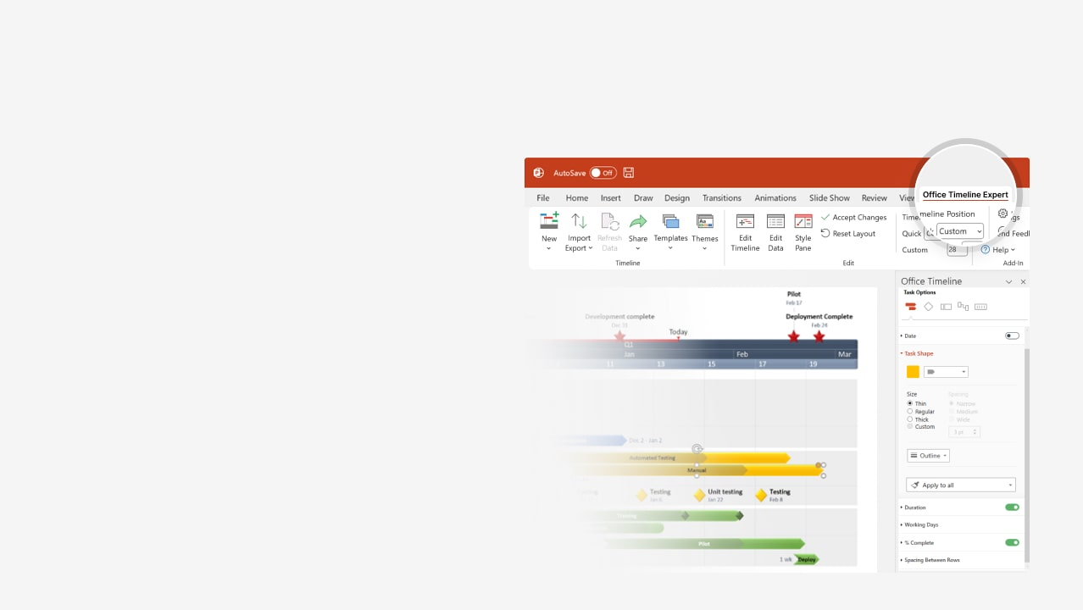

How to update this template in seconds
The Office Timeline add-in for PowerPoint will help you edit it with just a few clicks.
Get your free 14-day trial of Office Timeline here: https://www.officetimeline.com/office-timeline/14-days-trial Re-open this template, and create your impressive PowerPoint visual in 3 easy steps:
1
Click the Edit Data button on the Office Timeline tab.
2
Use the Data and Timeline views to edit swimlanes, milestones and tasks.
3
Click Save to instantly update the template.

Slide 2

Jun 12 - Jun 24
Jun 22 - Jul 20
Jun 12 - Jun 29
Jun 29 - Jul 20
Jul 19 - Aug 10
Jun 28 - Jul 14
Jul 14 - Jul 29
Jul 28 - Aug 14
Aug 13 - Aug 30
May 1 - May 17
May 18 - Jun 7
Jun 7 - Jun 22
Jun 8 - Jun 20
41.6 days
11.2 days
10.8 days
11.9 days
12.7 days
12.1 days
21 days
12 days
25 days
15 days
10 days
10 days
21 days
26 days
20 days
15 days
15 days
45 days
9 days
2025
2025
Today
Sep
Program
Plan Template
Create target list
Present findings to PM
Post program online
E-mail invitations
May 18
Jun 6
Jul 4
Jul 22
Q2
Q3
May
Jun
Jul
Aug
Day 1
15
29
43
57
71
85
99
113
May 1
Jun 20
Aug 16
Secure team support
Issue purchase orders
Issue certificates
Planning
Program Planning
May 1 - May 29
Define objectives
Community
Identify Community
May 18 - Jun 22
Training analysis
Prioritize needs
Deliverables
Vendors
Vendor Input
Jun 8 - Jul 7
Commitment
Start
Program Commencement
Jun 21 - Jul 28
Determine locations
Skills
Skill Assessment
Jun 12 - Aug 10
Identify recipients
Program award matrix
Finalize program budget
Implementation
Jun 28 - Aug 30
Program Implementation
Execute program
Collect feedback
Follow-up training
Report results

