Slide 1
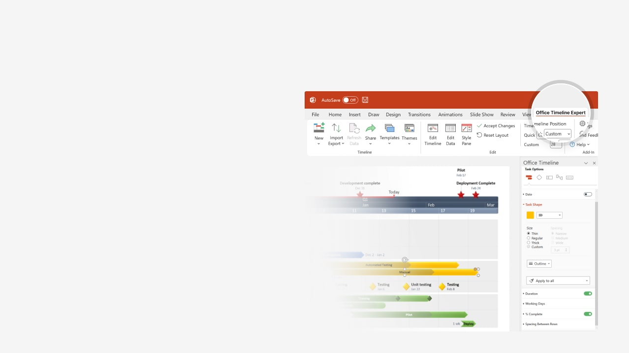

How to update this template in seconds
The Office Timeline add-in for PowerPoint will help you edit it with just a few clicks.
Get your free 14-day trial of Office Timeline here:
https://www.officetimeline.com/office-timeline/14-days-trial
Re-open this template, and create your impressive
PowerPoint visual in 3 easy steps:
1
Click the Edit Data button on the Office Timeline tab.
2
Use the Data and Timeline views to edit swimlanes, milestones and tasks.
3
Click Save to instantly update the template.

Slide 2

Daily Schedule Timeline
Winner named
Mark picks me up
My speech time
9:30 am
1:45 pm
5:00 pm
Jul 24
7 am
8 am
9 am
10 am
11 am
12 pm
1 pm
2 pm
3 pm
4 pm
Work out
7:30 a
45 mins
8:45 a
Get ready
8:50 a
35 mins
9:25 a
Drive
9:30 a
45 mins
10:15 a
Rehearsal
10:30 a
60 mins
11:30 a
Final tweaks
11:30 a
30 mins
12:00 p
Candidates' lunch
12:00 p
60 mins
1:00 p
Candidates' assembly
1:00 p
240 mins
5:00 p
Balloting
3:30 p
30 mins
4:00 p
Ballot count
4:00 p
45 mins
4:45 p

