Slide 1
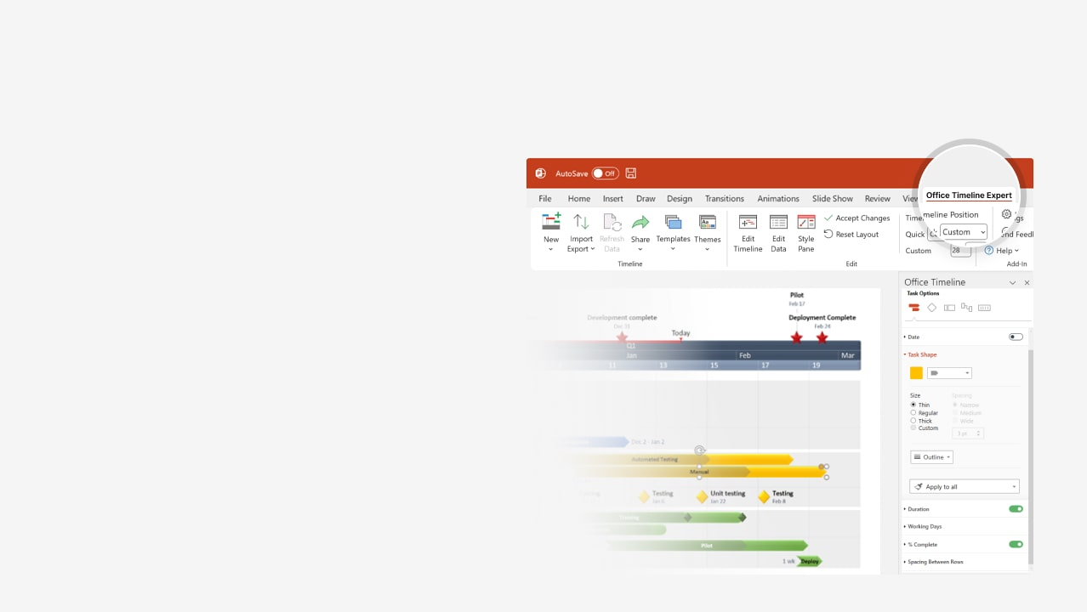

How to update this template in seconds
The Office Timeline add-in for PowerPoint will help you edit it with just a few clicks.
Get your free 14-day trial of Office Timeline here:
https://www.officetimeline.com/office-timeline/14-days-trial
Re-open this template, and create your impressive
PowerPoint visual in 3 easy steps:
1
Click the Edit Data button on the Office Timeline tab.
2
Use the Data and Timeline views to edit swimlanes, milestones and tasks.
3
Click Save to instantly update the template.

Slide 2

1-Year Plan
Policy Review
Reporting
Jul 10
Aug 26
Set Goals
Initial Goal Review
Jan 3
Launch
Expo
Jun 6
End-of-Year Review
Mar 9
Apr 22
Dec 1
Jan
Feb
Mar
Apr
May
Jun
Jul
Aug
Sep
Oct
Nov
Dec
May 2
Jul 5
Business Plan Review
Budget Adjustment
Mar 23
Feb 7
System Review
Project Kickoff
Jan 2
Sep 8
Oct 31
Budget
Maintenance
Risk Management

