Slide 1
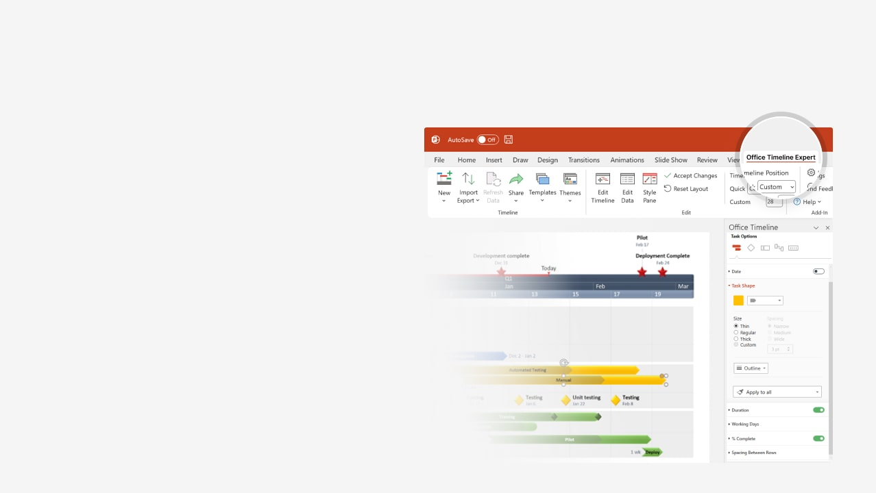

How to update this template in seconds
The Office Timeline add-in for PowerPoint will help you edit it with just a few clicks.
Get your free 14-day trial of Office Timeline here: https://www.officetimeline.com/office-timeline/14-days-trial Re-open this template, and create your impressive PowerPoint visual in 3 easy steps:
1
Click the Edit Data button on the Office Timeline tab.
2
Use the Data and Timeline views to edit swimlanes, milestones and tasks.
3
Click Save to instantly update the template.

Slide 2

Blank Timeline Template
Ninth Milestone or Event Here
First Milestone or Event Here
Nov 9
Seventh Milestone or Event Here
Oct 1
Third Milestone or Event Here
Fifth Milestone or Event Here
Feb 1
Today
Nov 22
Apr 1
Today
Jan 15
1990
1994
1998
2002
2006
2010
2014
2018
2022
2026
Oct
Feb
Jun
Oct
Feb
Jun
Oct
Feb
Jun
Oct
Feb
Jul 14
Mar 1
Jun 1
Feb 4
Second Milestone or Event Here
Fourth Milestone or Event Here
Eight Milestone or Event Here
Tenth Milestone or Event Here
Jul 1
Sixth Milestone or Event Here

