Slide 1
Library Management System
Final Project Presentation
CIS411 Group Project

Slide 2
Introduction
This Library Management System was built using Microsoft Access.
It tracks books, authors, members, staff, and book loans.
Includes data entry forms, reports, and complex queries.

Slide 3
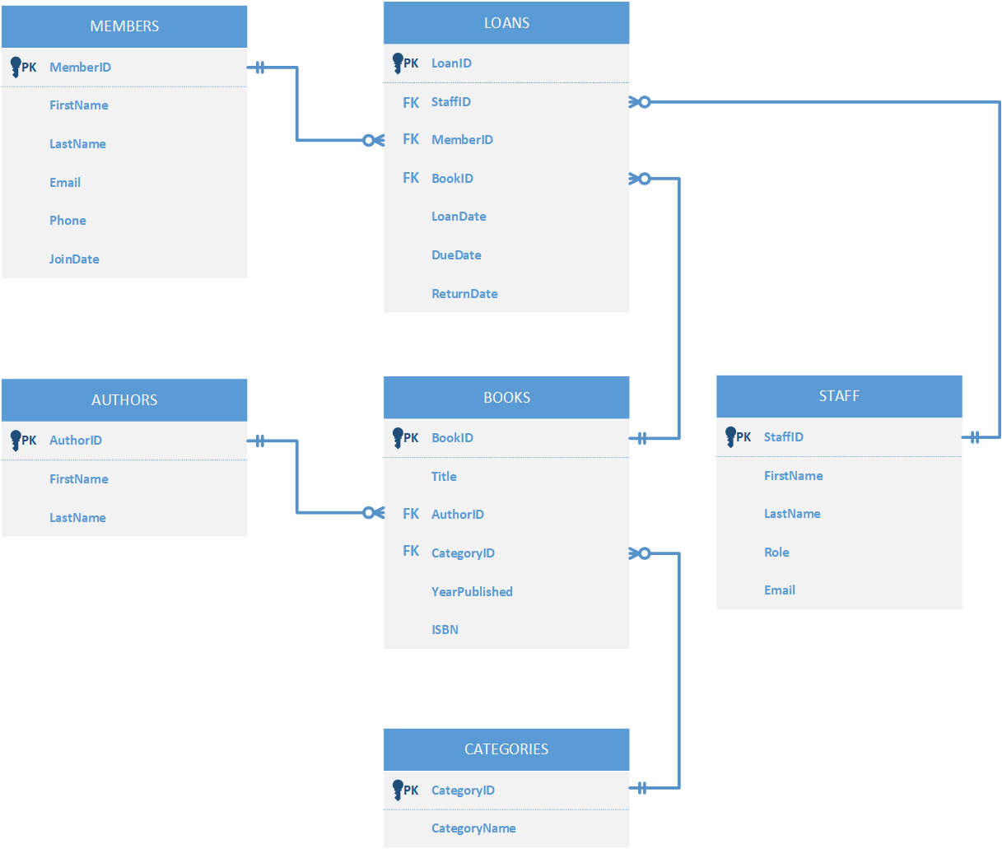
Entity Relationship Diagram

Slide 4
Normalization & Tables
All tables are in 3NF:
- Authors, Categories, Books
- Members, Staff, Loans
All attributes are only dependent on the primary key — not on other non-key attributes.
Normalization reduced redundancy and ensured data integrity.

Slide 5
Sample SQL Code & Queries
CREATE TABLE Authors (
AuthorID AUTOINCREMENT PRIMARY KEY,
FirstName TEXT(50),
LastName TEXT(50)
);
CREATE TABLE Staff (
StaffID AUTOINCREMENT PRIMARY KEY,
FirstName TEXT(50),
LastName TEXT(50),
Role TEXT(50),
Email TEXT(100)
);
CREATE TABLE Members (
MemberID AUTOINCREMENT PRIMARY KEY,
FirstName TEXT(50),
LastName TEXT(50),
Email TEXT(100),
Phone TEXT(15),
JoinDate DATE
);
CREATE TABLE Categories (
CategoryID AUTOINCREMENT PRIMARY KEY,
CategoryName TEXT(50)
);

Slide 6
Sample SQL Code & Queries
CREATE TABLE Books (
BookID AUTOINCREMENT PRIMARY KEY,
Title TEXT(100),
AuthorID LONG,
CategoryID LONG,
YearPublished INT,
ISBN TEXT(20),
FOREIGN KEY (AuthorID) REFERENCES Authors(AuthorID),
FOREIGN KEY (CategoryID) REFERENCES Categories(CategoryID)
);
CREATE TABLE Loans (
LoanID AUTOINCREMENT PRIMARY KEY,
MemberID LONG,
BookID LONG,
StaffID LONG,
LoanDate DATE,
DueDate DATE,
ReturnDate DATE,
FOREIGN KEY (MemberID) REFERENCES Members(MemberID),
FOREIGN KEY (BookID) REFERENCES Books(BookID),
FOREIGN KEY (StaffID) REFERENCES Staff(StaffID)
);

Slide 7
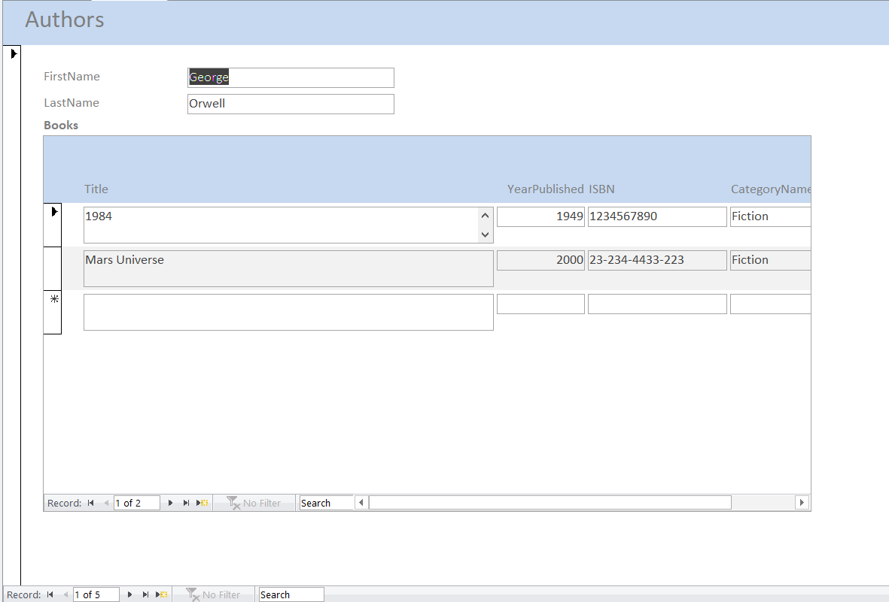
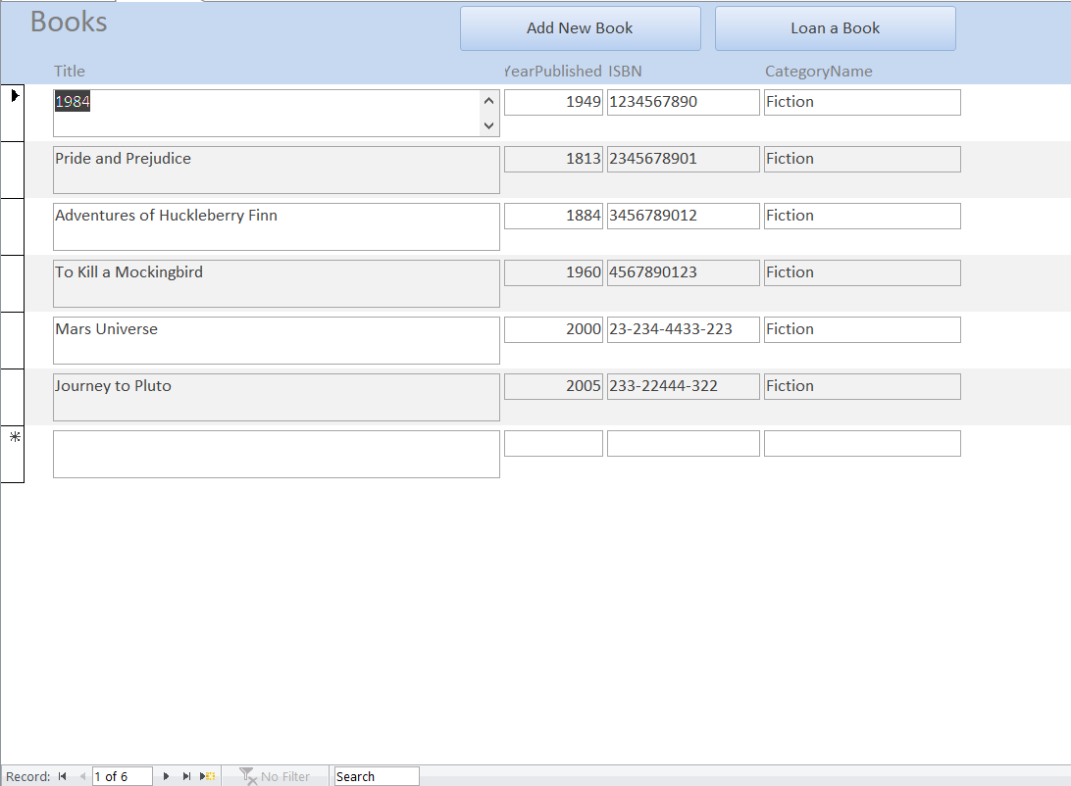
Forms
Books form
Authors form

Slide 8
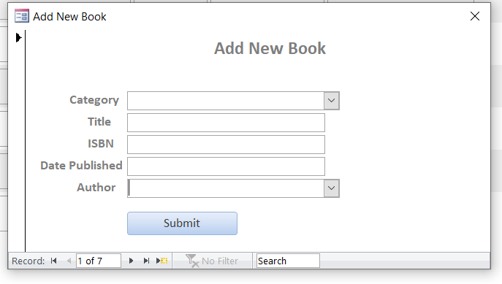
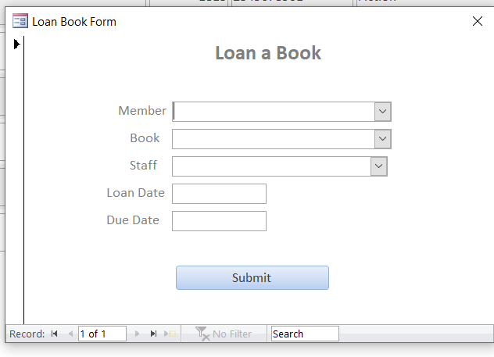
Forms
Loan a book form
Add new book form

Slide 9
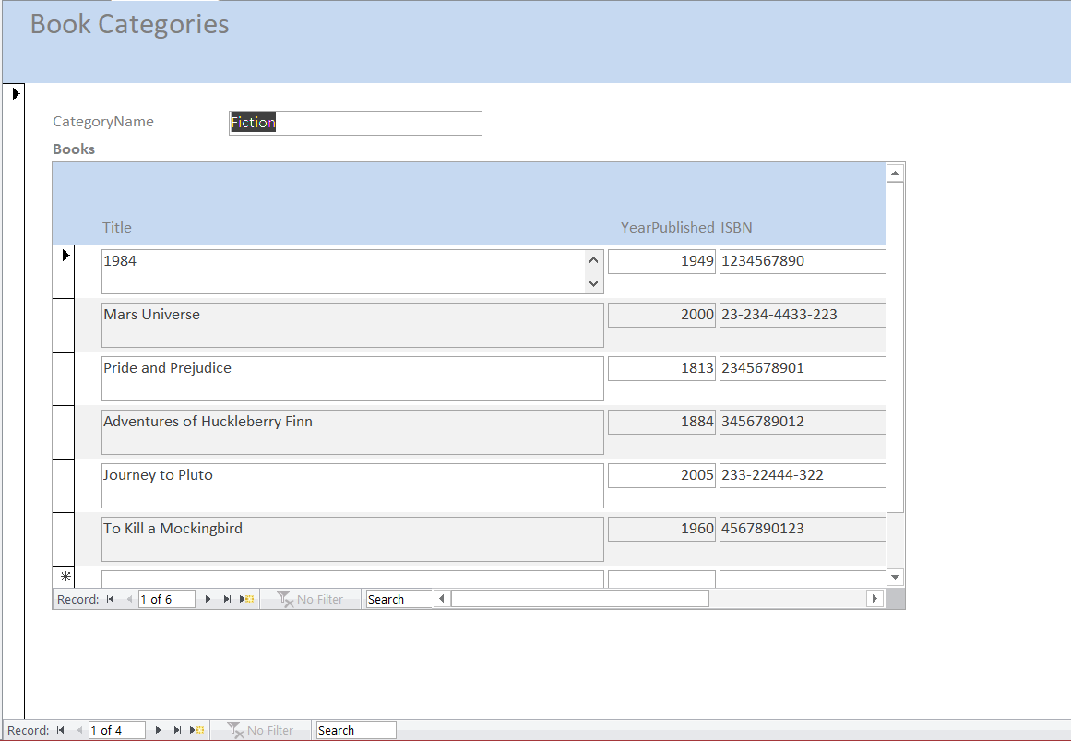
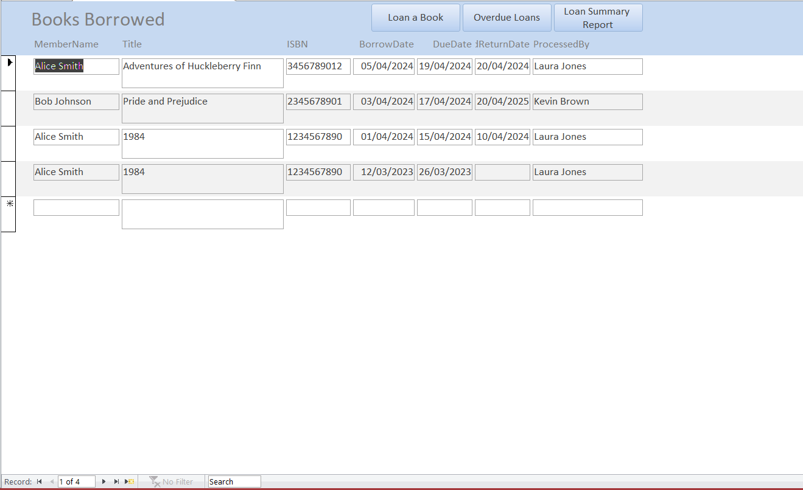
Forms
Book Categories form
Books borrowed form

Slide 10
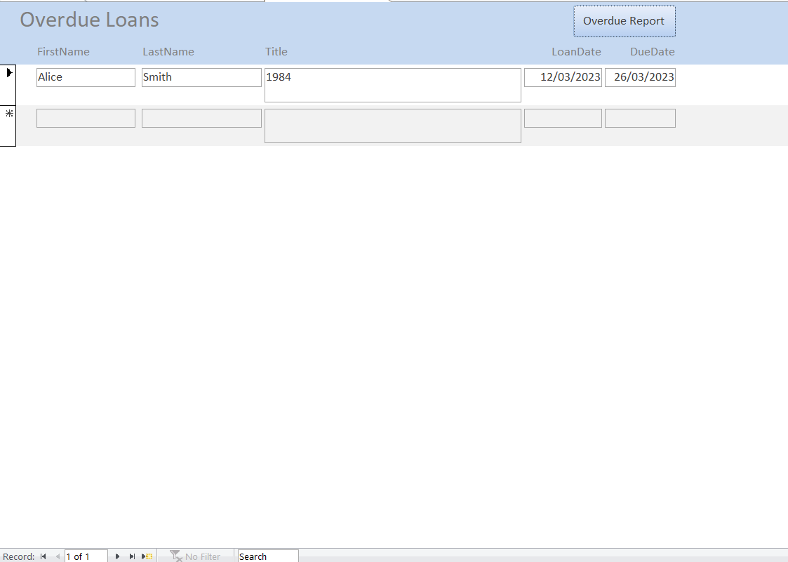
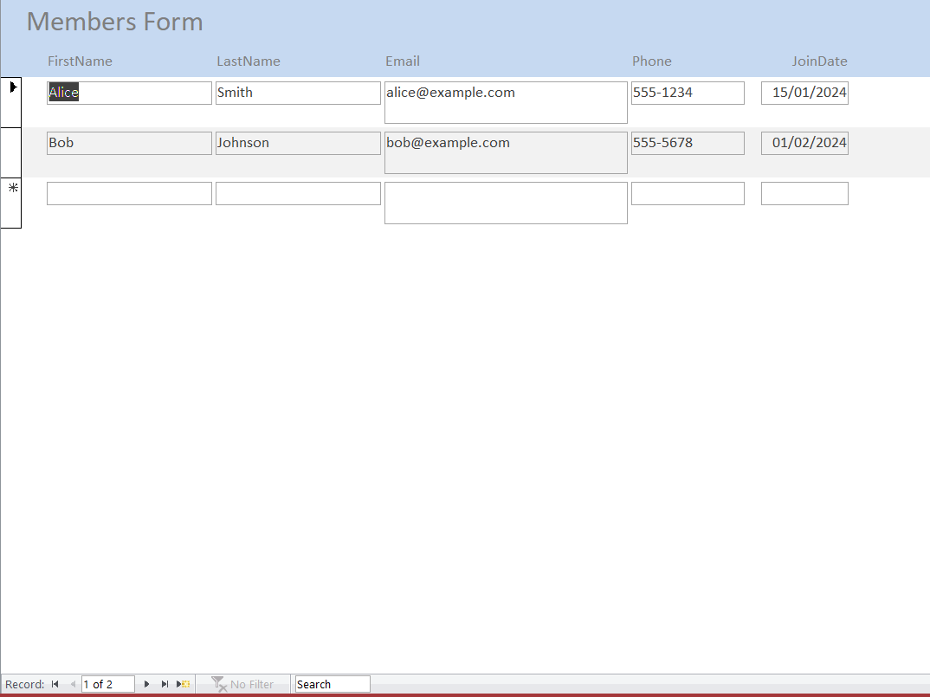
Forms
Overdue loans form
Library members form

Slide 11
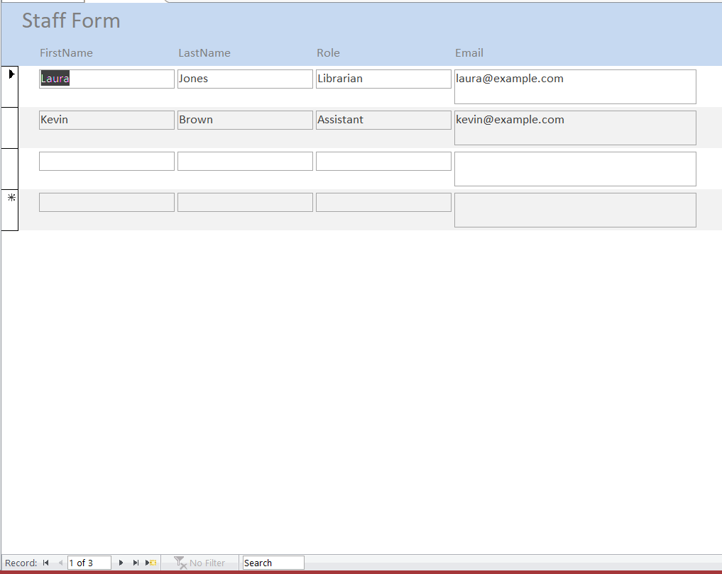
Forms
Staff form

Slide 12
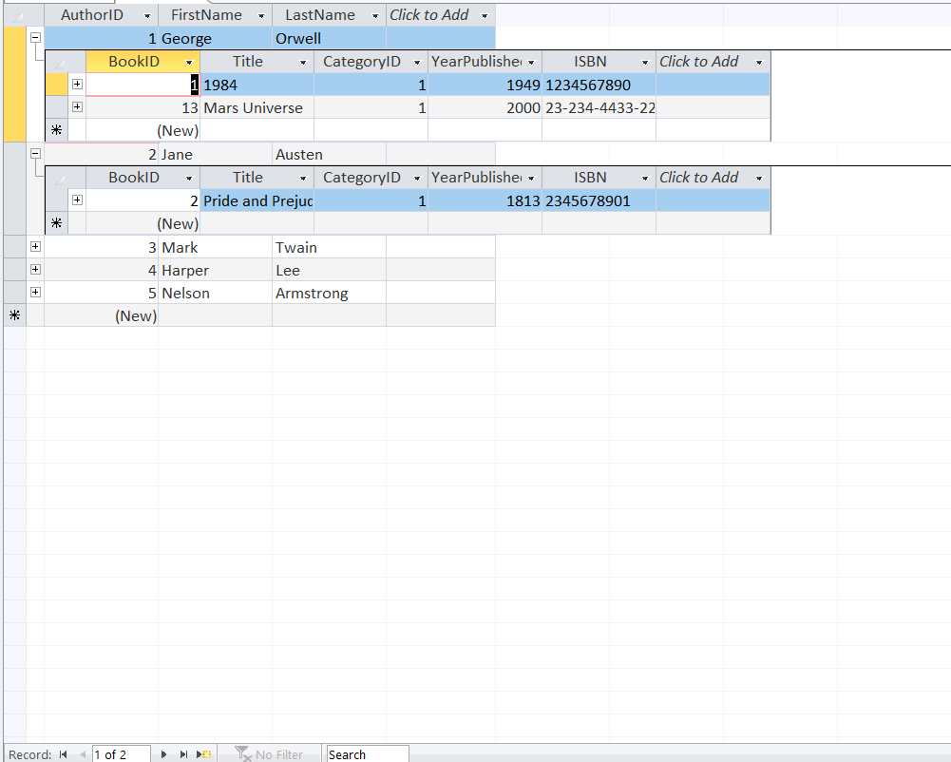
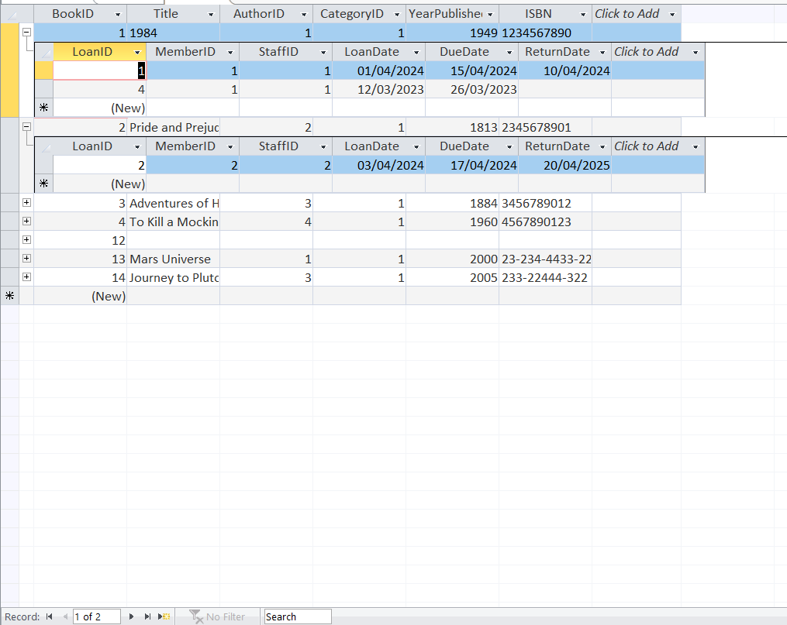
Datasheets
Authors datasheet
Books datasheet

Slide 13
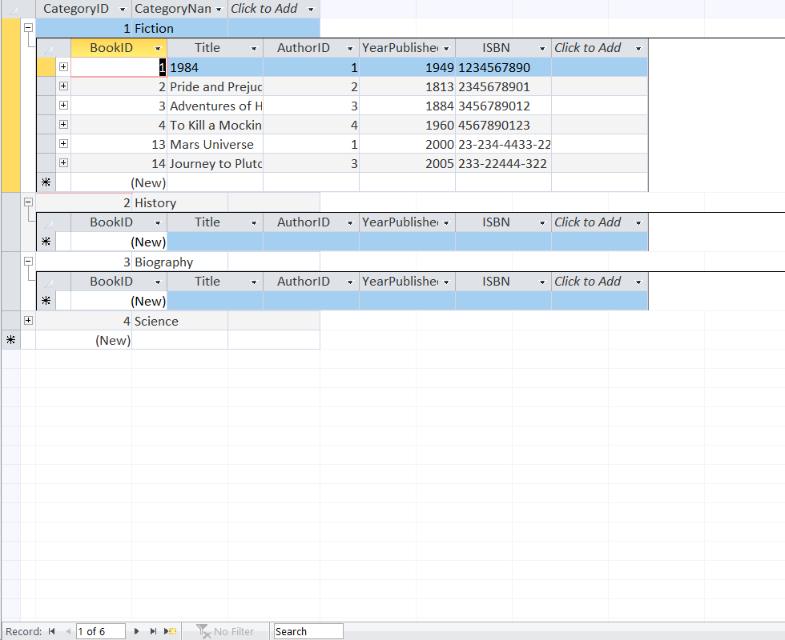
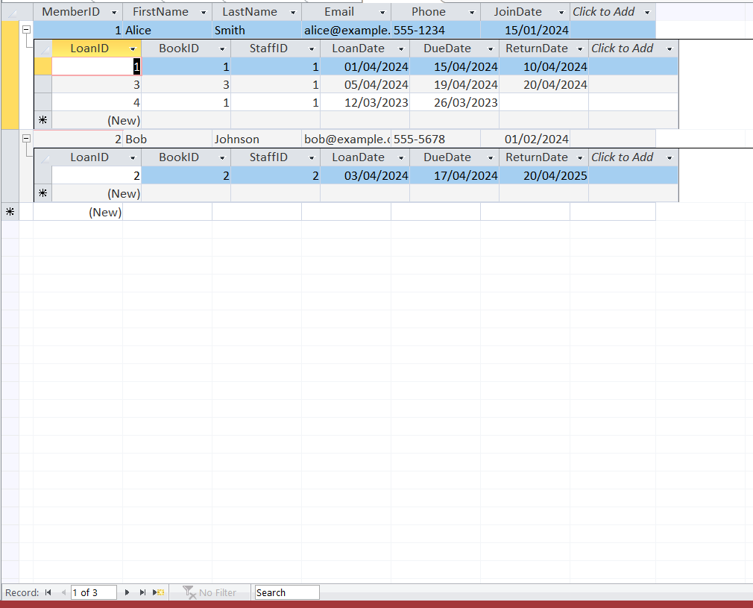
Datasheets
Categories datasheet
Members datasheet

Slide 14
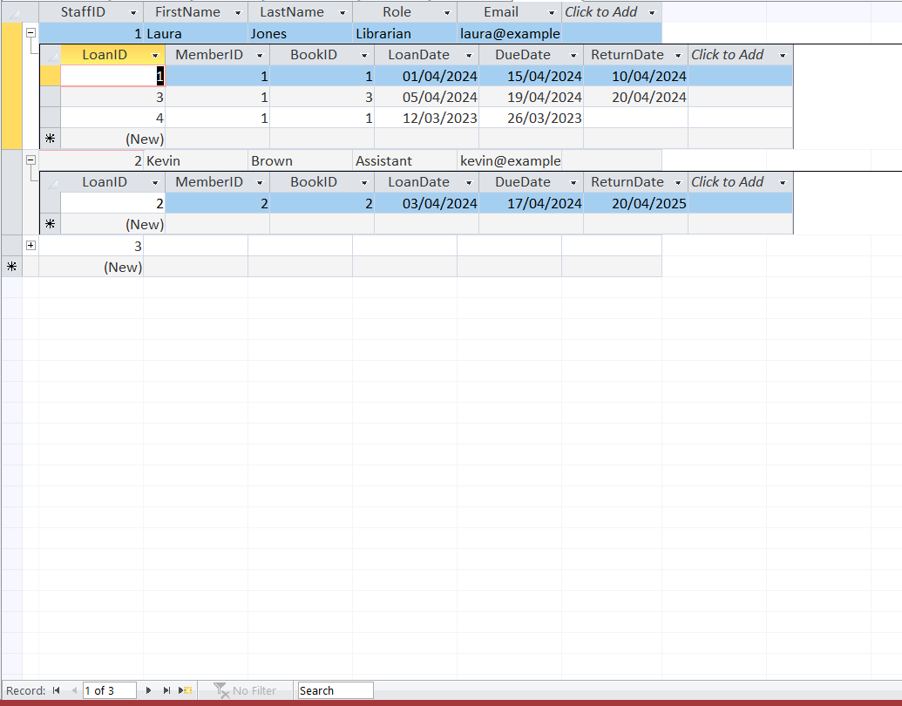
Datasheets
Staff datasheet

Slide 15
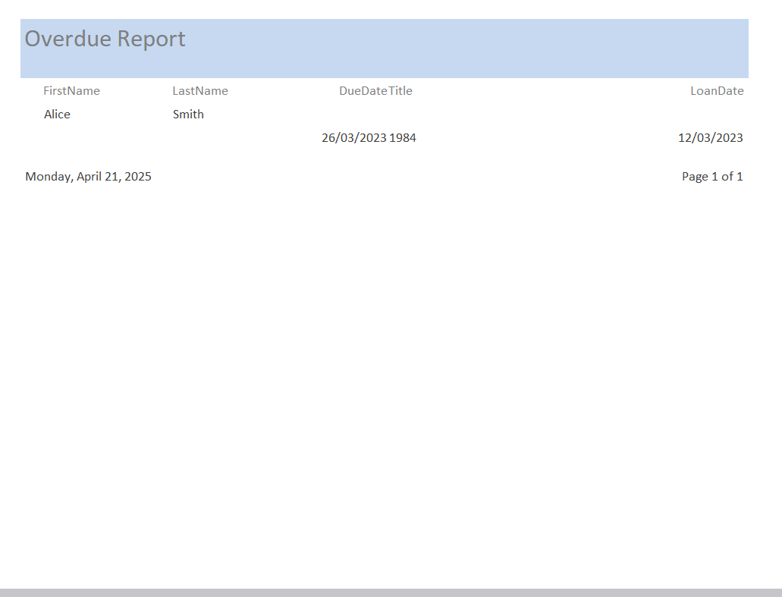
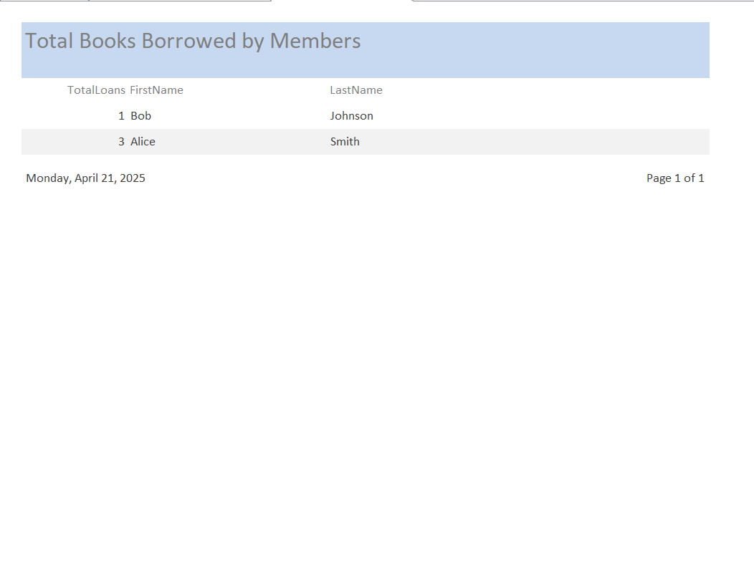
Reports
Overdue report
Books borrowed report

Slide 16
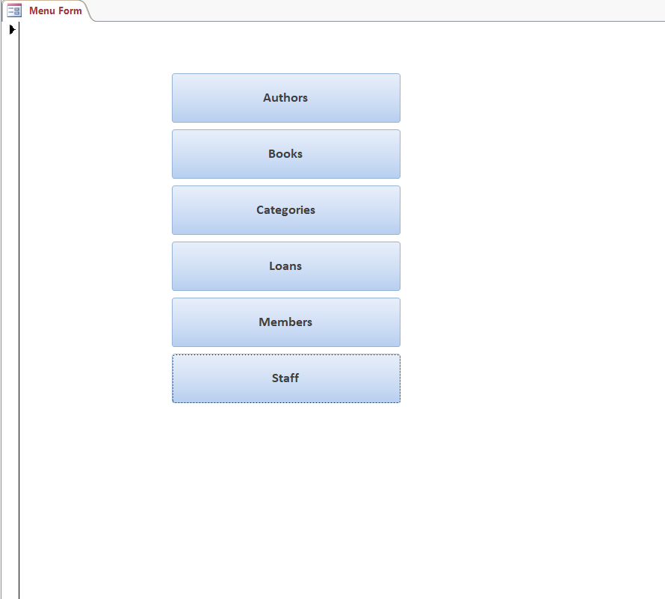
Navigation Form
Navigation menu form

Slide 17
Challenges & Lessons
Challenges:
Writing multi-table queries
Designing well-structured forms
Ensuring 3NF and referential integrity
Lessons:
Learned SQL
Access form/report building
Database normalization.

Slide 18
Recommendations
Move to a web-based platform for scalability
Add user authentication and role-based access
Integrate email reminders for due dates
Include real-time analytics and availability checks

Slide 19


Thank You!
Questions or feedback?

